Slide 1
Nau mai ki Te Poari Hauora o Te Tai Tokerau
Welcome to Northland District Health Board

Slide 2
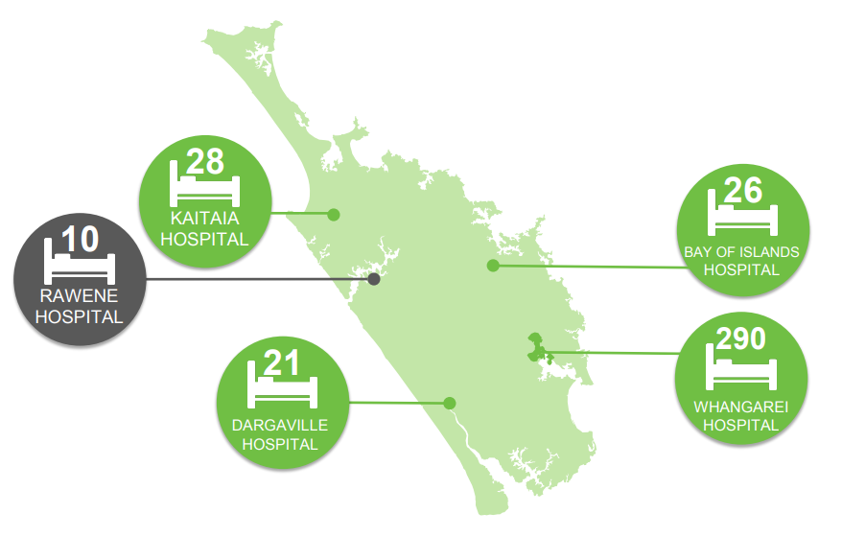
About Us
We cover one of the largest geographical regions in the country, from Cape Reinga in the north to Te Hana in the south.
Our four hospitals are located in:
Whangarei
Dargaville
Bay of Islands (Kawakawa)
Kaitaia
These services are supplemented by a network of community based outpatient and mental health services, a range of allied health services and public and population health unit across Northland.
Some specialist services like radiation treatment and rheumatology services are provided from Auckland or through visiting specialists travelling to Northland.

Slide 3
Our Population
Northland population estimated at 193,170 in 2020/21
Whangarei District had the highest population of 98,300, followed by the Far North and Kaipara District with 68,500 and 24,100 respectively.
Northlands population tends to be significantly older than the national average – 20% over the age 65.
Northland has a much higher proportion of Maori (36%) and lower proportion of Pasifika (2%) compared to the national average.
Rurality and high rates of deprivation
Out population has some of the highest rates of coronary artery disease, diabetes, lung cancer, chronic respiratory disease, stroke and asthma.

Slide 4
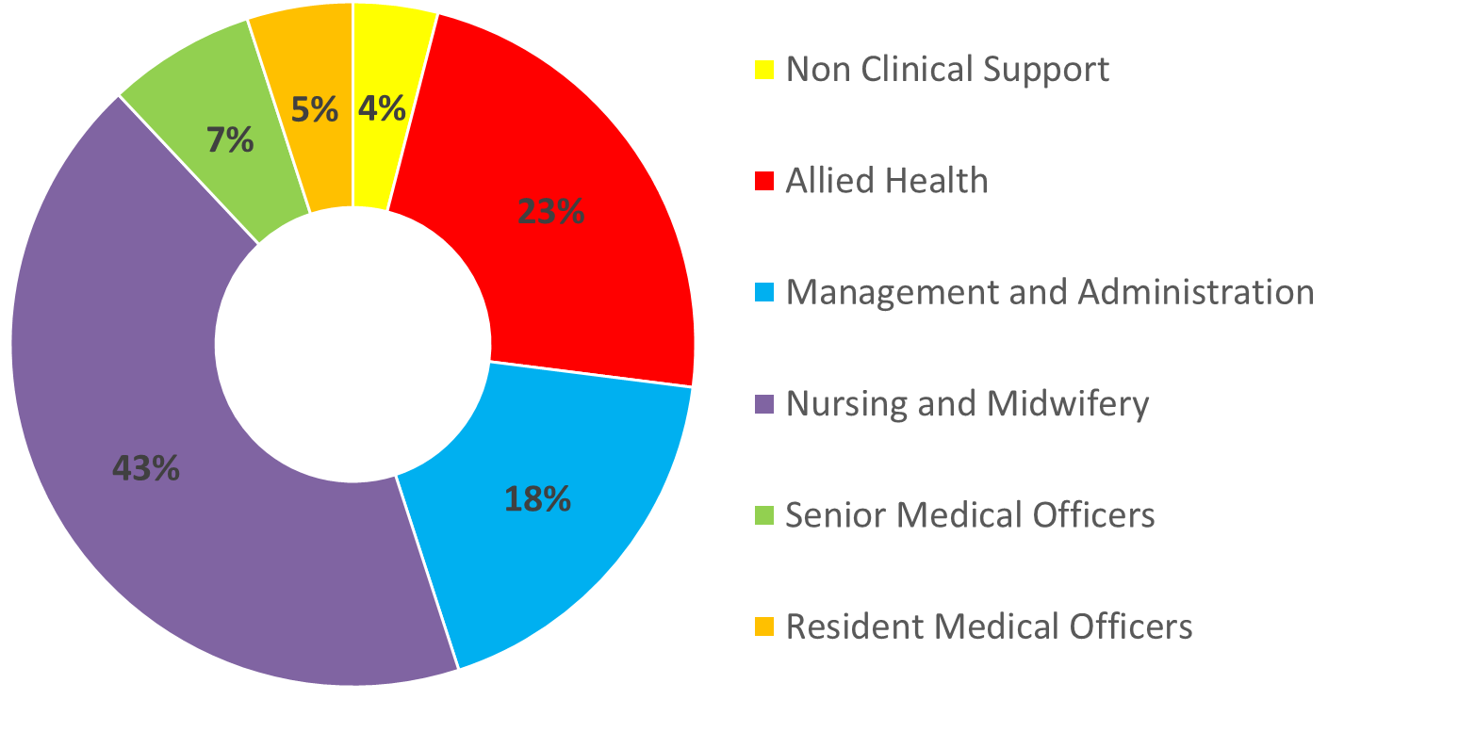
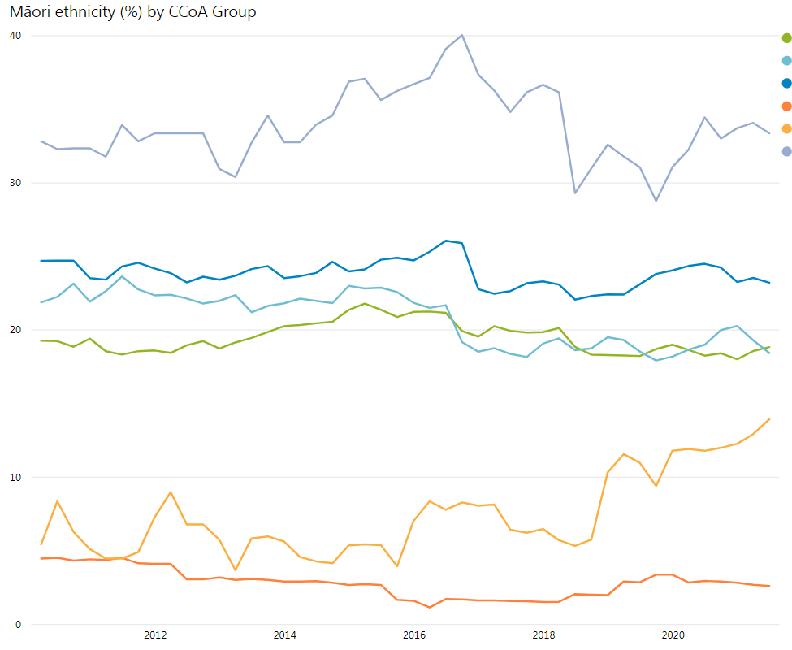
Our Workforce
We are a medium sized DHB
We are growing the representation of Maori in our workforce

Slide 5
Our Values

Slide 6
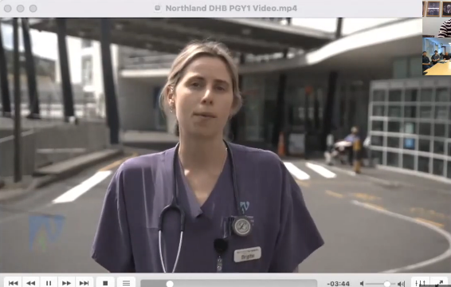
Insights From Our Team

Slide 7
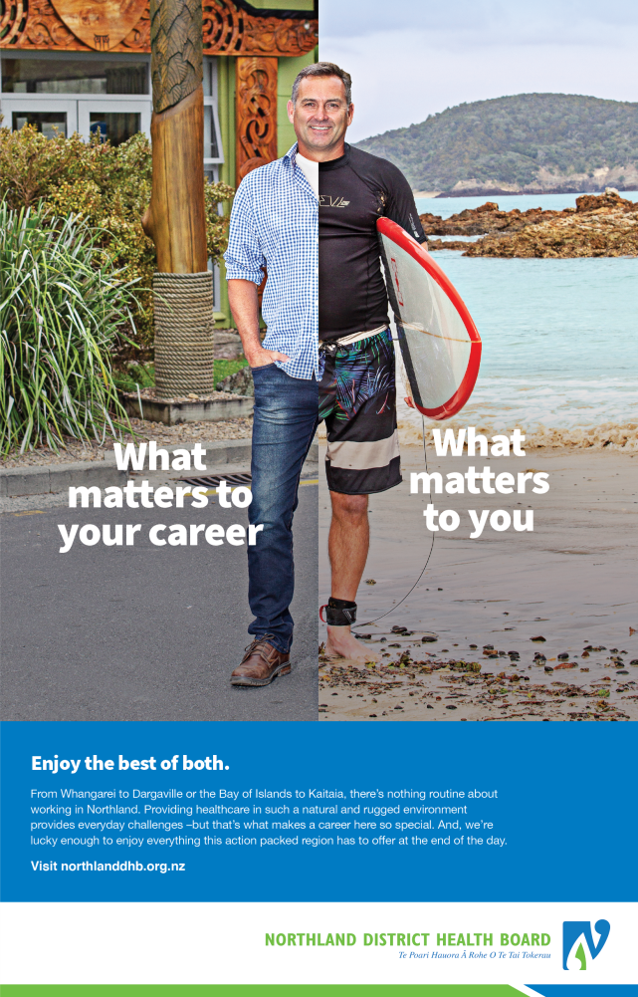
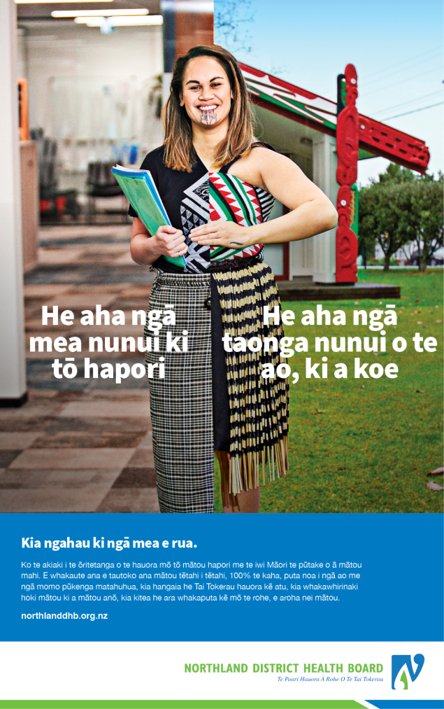
Why Northland?

Slide 8
Why Choose Northland DHB?
Choose Whangarei for the first step of your medical career. Be close to the action with small teams, a wide variety of services and plenty of opportunities to learn and improve. Make Whangarei your home for two years or more and spend time in the highly regarded ED, Paeds or as an O&G house officer working side by side with consultants.
Work in an environment that is about supporting your development. Get to work alongside specialists, be able to access support for further study and take advantage of a workplace that rewards those who want to go above and beyond.
On- site benefits we offer
RMO lounge Professional Experience
On-site clinical library Sociable working conditions
Free on-site 24/7 staff gym Great Training
Free on-site seasonal outdoor swimming pool Hands on learning
On-site cafeterias Voluntary bonding scheme

Slide 9
Vocational Training
Northland DHB is committed to training with support for courses, diplomas and study.
• Anaesthesia • Emergency Medicine
• ENT/ORL • General Medicine
• General Surgery • Geriatrics
• Intensive Care • Orthopaedics
• Paediatrics • Psychiatry
• Renal • Urology
Training in a regional centre provides excellent “hands on”, well supervised training. Whangarei has close links with Auckland hospital which provides tertiary care and many sub-specialists do outreach clinics in Whangarei. There are also close links with tertiary centres for educational purposes. There are positions available for basic and advanced trainees with college accredited Registrar training jobs in most specialties.

Slide 10
Selection Criteria
We are holding brief interviews and encourage you to contact our RMO Unit on 09 430 4101 x 60958 or rmo.unit@northlanddhbb.org.nz to arrange a time to see us face to face or through Zoom.
We are interested in hearing from you on:
Your reasons for choosing Northland DHB
What do you see as the benefits of training away from a large training centre?
In Northland there are significant inequities in health outcomes between Māori & Pākeha, what changes to the health system can most reduce the health inequities suffered by Māori?
How will you contribute to healthcare in Northland

Slide 11
Application and Offer Dates
Applications open
14 March 2022
Applications Close
8 July 2022
Offers Made By
5 September 2022
Acceptances by
12 September 2022

Slide 12
Thank you

