Slide 1
Welcome to Whakatane Hospital
ACE ROADSHOW 2022

Slide 2
Recruitment
Who are we?
The process
Who we look for?
What we offer?

Slide 3
Who are we?
RMOS:
Anna Bergin Anna.Bergin@bopdhb.govt.nz
Anaru Williams Anaru.Williams@bopdhb.govt.nz
Karleigh OConnor Karleigh.OConnor@bopdhb.govt.nz
Siska Falconer Fransiska.Falconer@bopdhb.govt.nz
Introducing
Shantelle Arnesen Shantelle.Arnesen@bopdhb.govt.nz
Med Staffing Unit Administrator Whakatane
Dr. Kelly Phelps-ED Consultant/RMO PVS Supervisor

Slide 4
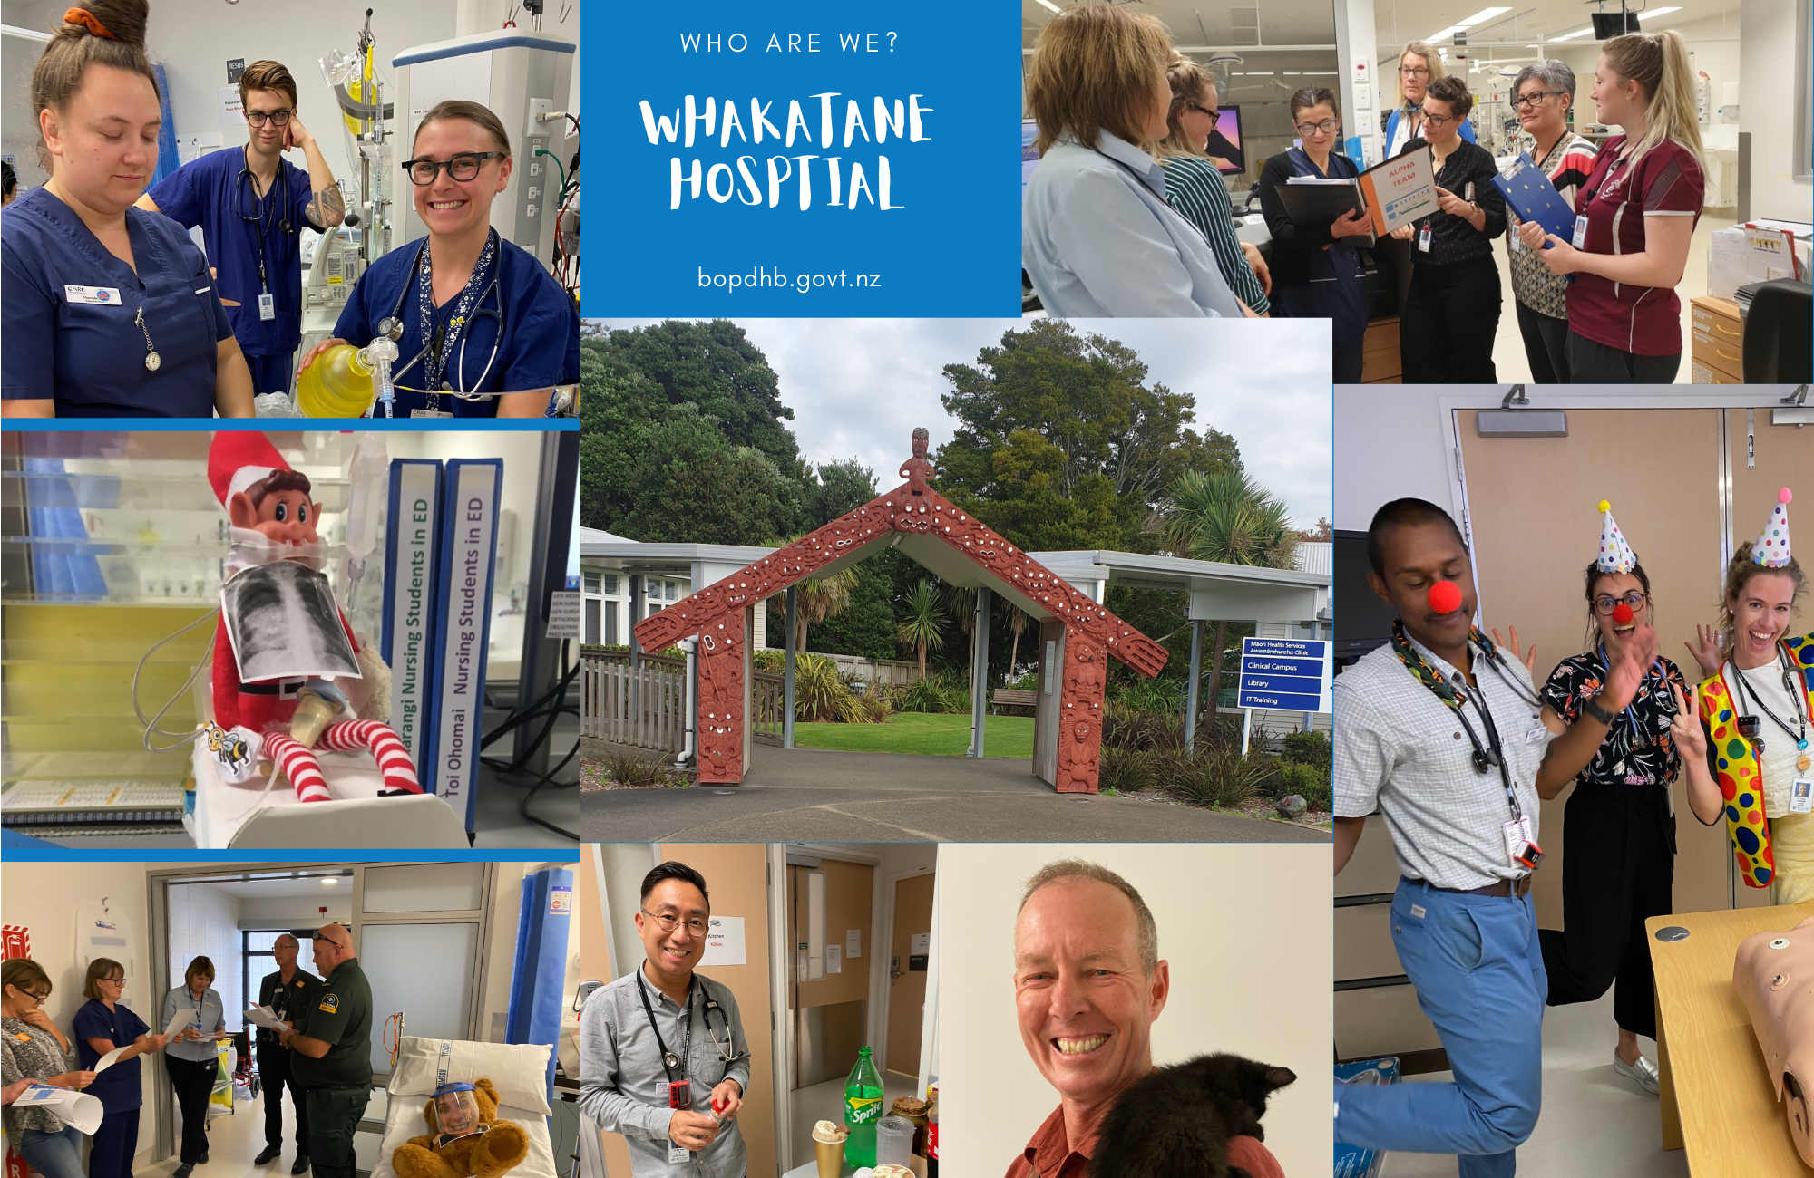

Slide 5
Receive
Review
Shortlist
Interview
Rank
The process
VIA

Slide 6
Receive
Review
Shortlist
Interview
Rank
The process
APPLICATIONS REVIEWED BY
Educational Supervisors in partnership with
PGY2
RHIP Programme
Medical Staffing
Maori Health

Slide 7
Receive
Review
Shortlist
Interview
Rank
The process
WE LOOK FOR;
Personalised cover letter
CV
References
Academic score
Rural aspirations
Cultural identify
Prior contact

Slide 8
Receive
Review
Shortlist
Interview
Rank
The process
VIA Video Conference

Slide 9
Receive
Review
Shortlist
Interview
Rank
The process
Combination of all elements

Slide 10
Is a visit required?
A visit is not essential but helpful in experiencing our manaakitanga.
Contact us via email: Shantelle Arnesen Shantelle.Arnesen@bopdhb.govt.nz

Slide 11
Who we’re looking for
Learner
Advocator
Our future
Adaptable
Collaborator
Respectful
Whanau focus
Compassionate

Slide 12
What we offer?

