Slide 1
Midcentral District Health Board and Palmerston North City
New Zealand's best kept secret

Slide 2
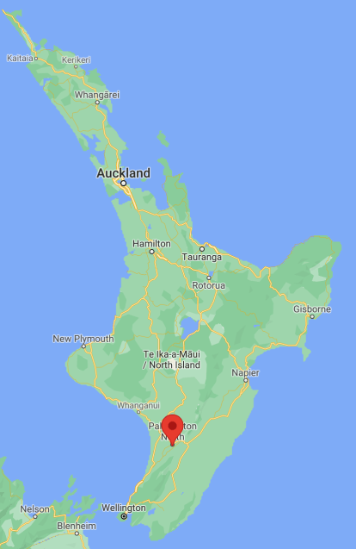

Slide 3
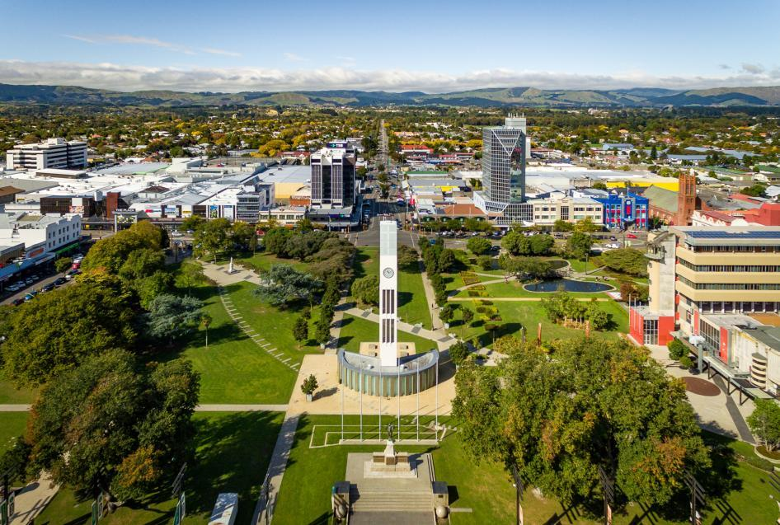
Notes:
Town centre - famous clock tower and surrounding park

Slide 4
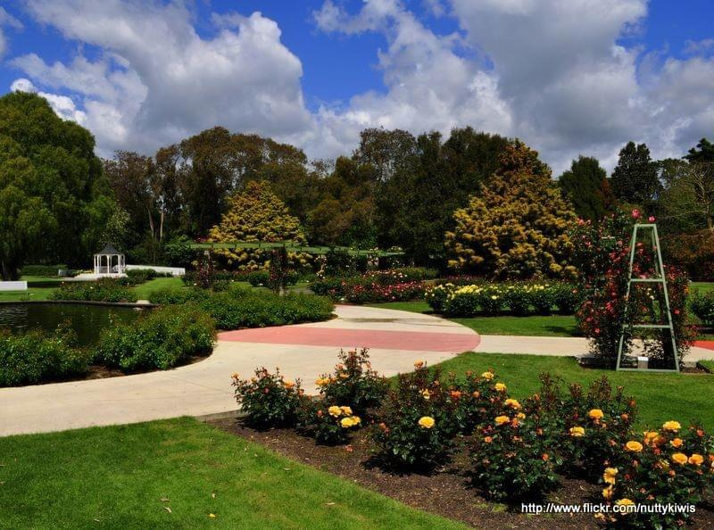
Notes:
Esplanade gardens

Slide 5
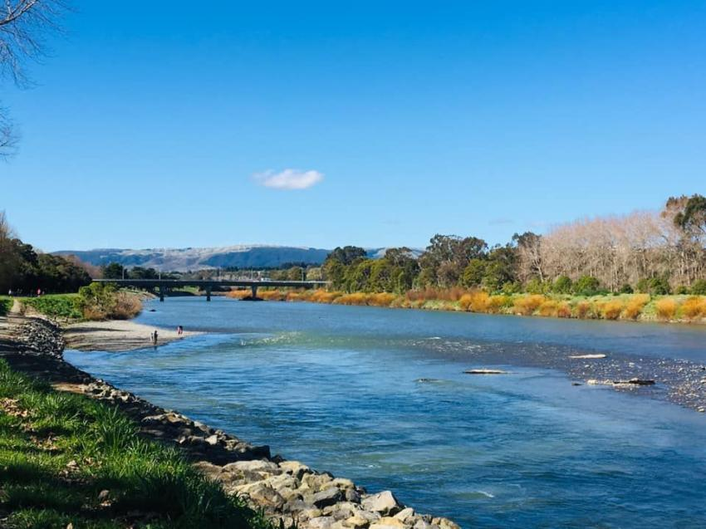
Notes:
The River trail

Slide 6
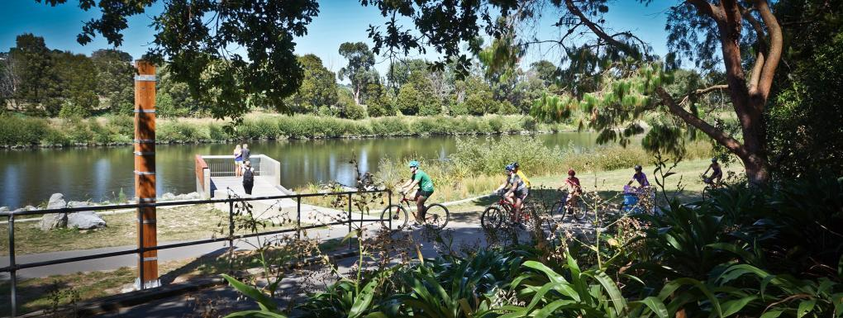
Notes:
Biking by the river

Slide 7
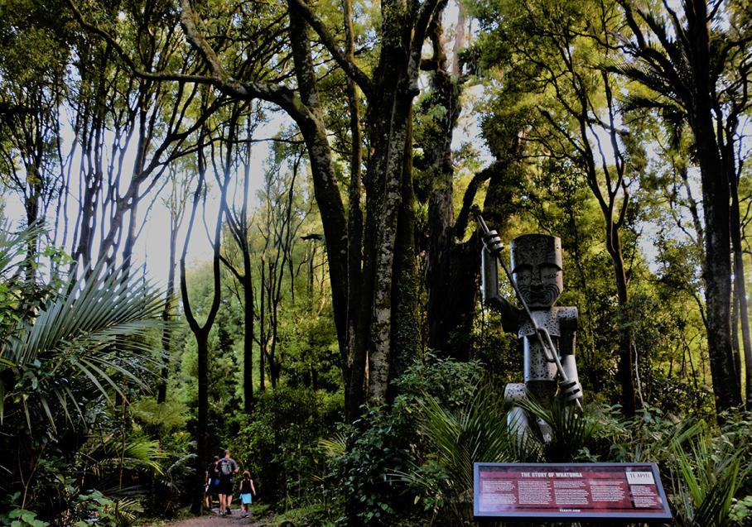
Notes:
Gorge trail

Slide 8
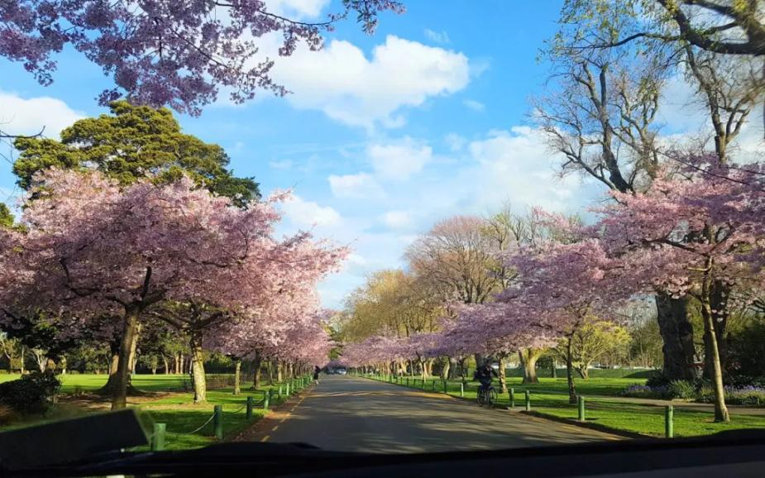

Slide 9
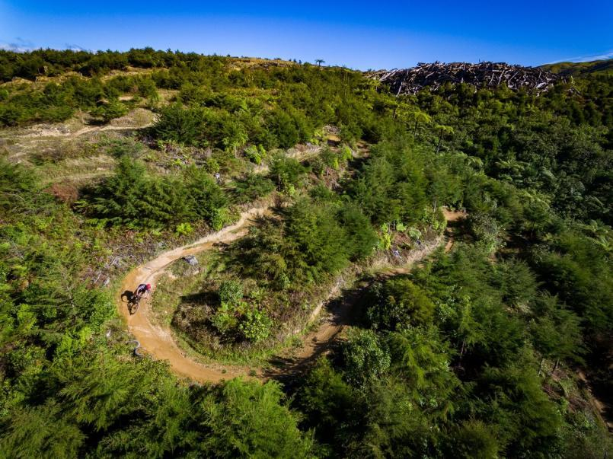
Notes:
Arapuke forest trail..

Slide 10
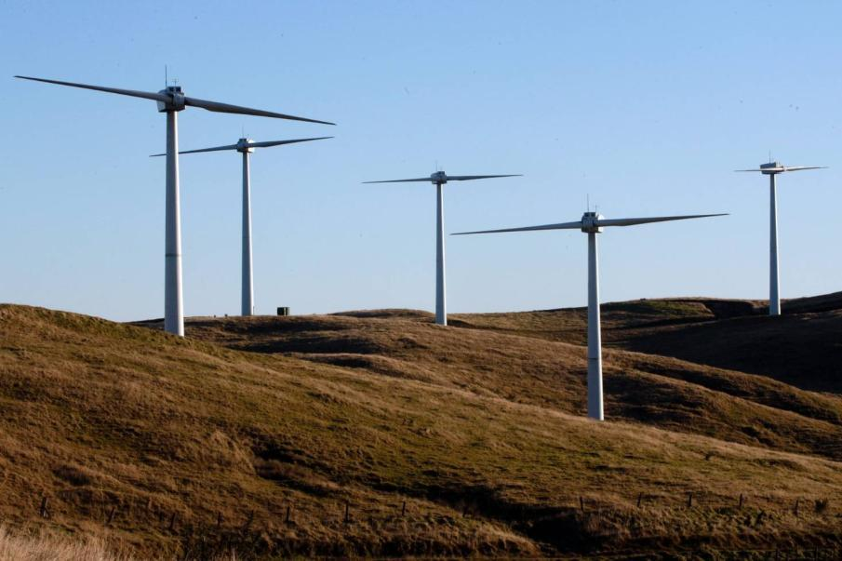
Notes:
Arapuke forest trail..

Slide 11
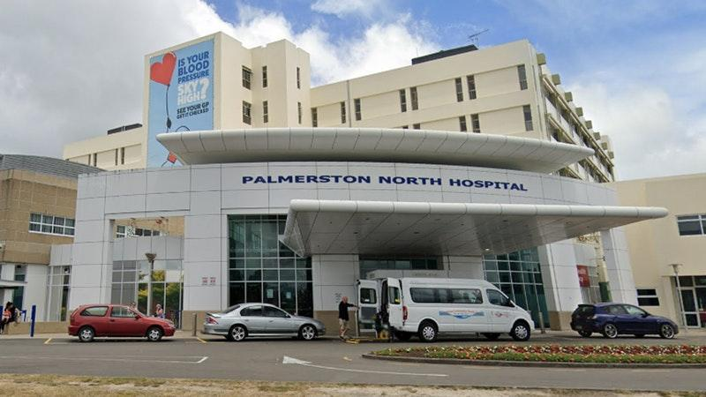

Slide 12
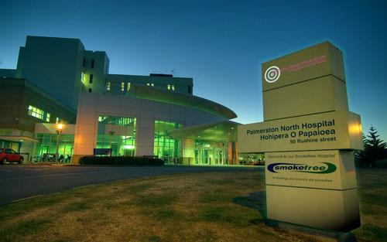

Slide 13
Where are we and what do we offer?
Palmerston North City is located in the heart of the Manawatū in the Lower North Island
The beautiful Manawatū River runs through the city with a riverside walking path, an esplanade and lots of outdoor areas to enjoy
It is 30 minutes to the beach and two hours to Wellington, ski-fields and only a little bit longer to multiple other great destinations (Hawkes bay, New Plymouth, Martinborough)

Slide 14
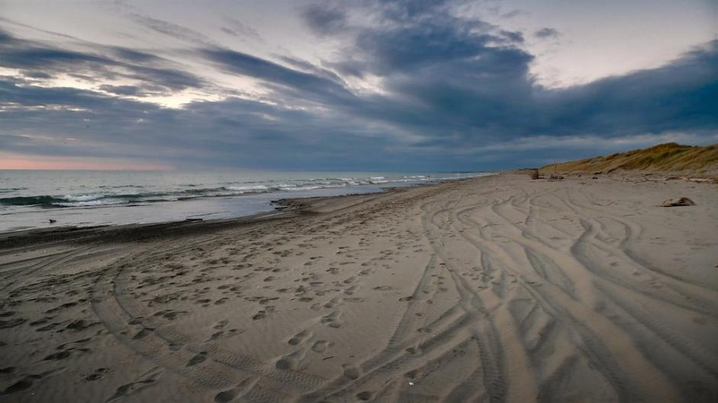

Slide 15
Where are we and what do we offer?
Palmerston North boasts more cafes and restaurants per head of population than anywhere else in New Zealand
There are no traffic jams – getting to work is a breeze and heading out of town for the weekend even easier
Flat, perfect for biking or walking to work.
Airport, accommodation, gyms in close proximity to hospital → house buying opportunities!

Slide 16
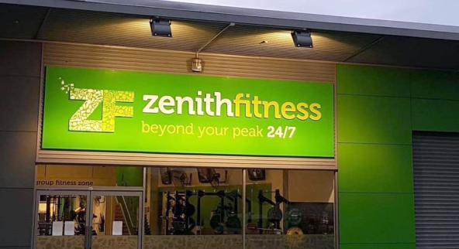
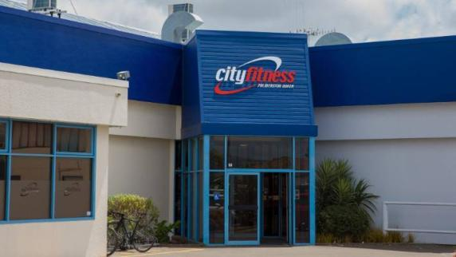
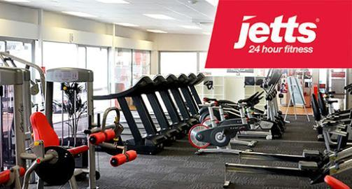

Slide 17
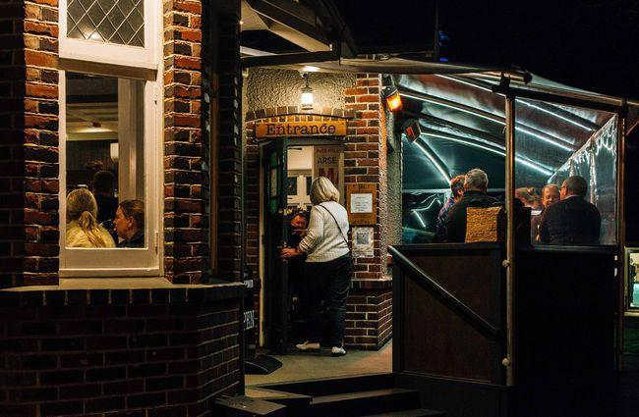

Slide 18
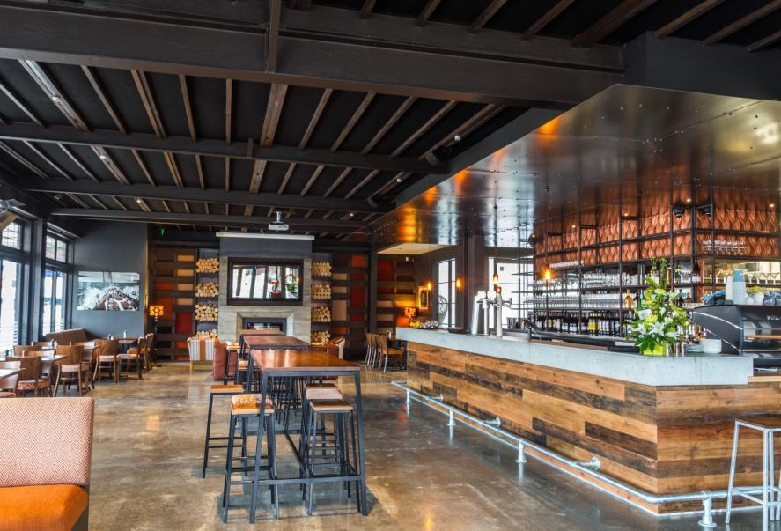

Slide 19
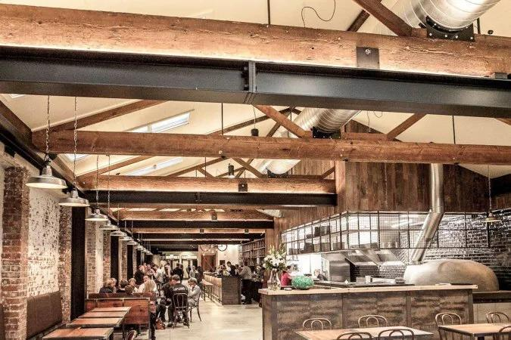

Slide 20
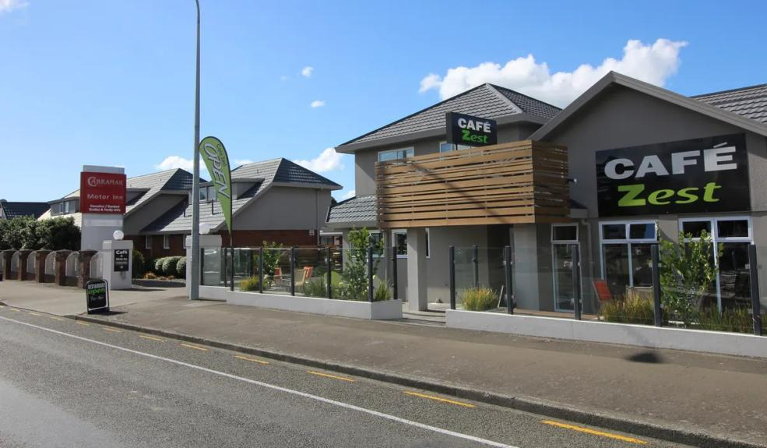

Slide 21
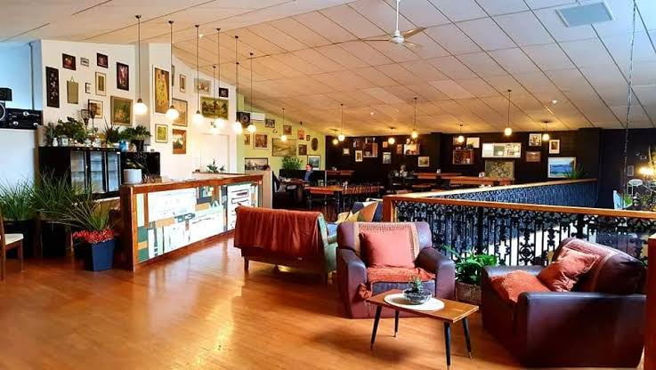

Slide 22
What about the DHB and the hospital?
MidCentral DHB covers the area from Pekapeka in the south to Apiti in the north and from the Tasman Sea to the Pacific Ocean.
Palmerston North Hospital has 350 beds providing most clinical services with the exception of plastics, cardiothoracic and neurosurgery
The Cancer Treatment Service is tertiary providing care to the region from Taranaki to Hawkes Bay which means a lot of really interesting pathology

Slide 23
What about the DHB and the hospital?
There are about 160 SMOs and 170 house officers and registrars
It is a really collegial place to work - everyone knows each other
SMO's great to work with, becomes easy to phone specialties - you grow to know most of the people you contact
Very easy to get imaging scans organised in Palmerston North Hospital

Slide 24
What runs can I do in PGY1 and PGY2
In PGY 1 the following runs are available:
General Surgery, Orthopaedics, Urology, ENT/Ophthalmology, General Medicine, Geriatric Medicine, Respiratory and from Q4 Obstetrics and Gynaecology and Psychiatry
In PGY2+ you can also do:
Medical Education, Medical Imaging,Emergency Medicine, Paediatrics, Haematology, Radiation Oncology, Medical Oncology, Cardiology, Renal and community based attachments in General Practice, St John Ambulance and Hospice + Inpatient Palliative Care
In PGY3+ - ICU SHO position and apply for Registrar roles

Slide 25
What should I put in my ACE application?
If you are interested in being ranked for MidCentral DHB the following things are important to include in your application:
Cover letter outlining why you want to come to Palmerston North and in particular any links you have to the city or region
Your CV should include information about you as a person – what you do in your spare time, previous employment (including holiday jobs) and other qualifications
We DO NOT interview but we do welcome visits or phone calls if you would like to know more about us and to tell us more about yourself
If you would like to be considered for a part time position please contact: christine.wood@midcentraldhb.govt.nz to discuss further

Slide 26
What else makes MidCentral special?
We have a keen team of house-surgeons working to develop our teaching programme for PGY1 and PGY2s
Most of the departments have robust teaching programmes as well so there are lots of learning opportunities
For interns who identify as Māori we have a Pre-Vocational Education Supervisor who is Māori.
Trainee interns regularly learn here, lots of teaching/mentoring opportunities - adds a lot to the culture, makes us better doctors

Slide 27
What else makes MidCentral special?
Incidence of susceptible malignant hyperthermia patients presenting for anaesthesia in the Manawatū-Horowhenua region is relatively high
Large susceptible family, and partly because of this, testing for MH susceptibility was commenced at Massey University in 1978.
Testing was subsequently taken over by the Palmerston North Hospital Anaesthetic Department in 1986
Notes:
*NEW SLIDE*

Slide 28
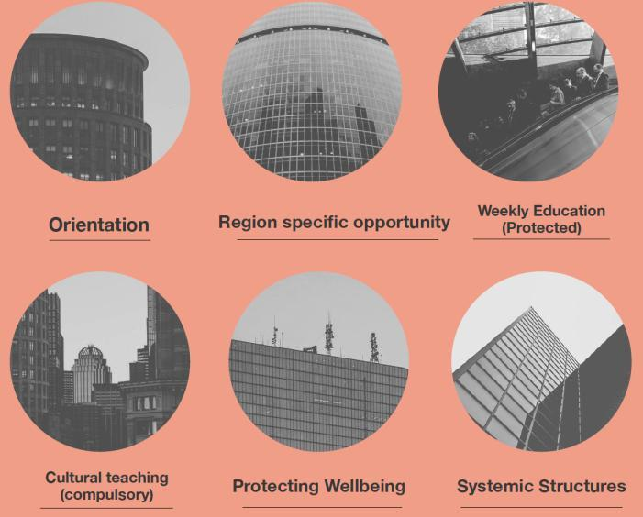

Slide 29
Orientation
Week of learning, bonding with new colleagues
Meet education supervisors
Understanding prescribing
Common MET calls simulations
Vascular access with ultrasound
The Amazing Race - learn the hospital and its procedures
ATLS course
Shadow/buddy shifts
Tips from more senior house-surgeons, and registrars

Slide 30
Region Specific Opportunity
Run specific
Lots of experience ascertained –
Lots of registrar opportunities - easy to step up
Great place to do O&G - with concomitant diploma
Great place to do Paediatrics - with concomitant diploma
ICU SHO job in third year provides amazing experience
E.D six month placements - very hands on
Medical Education House Officer position for those interested in teaching
Medicla Imaging House Officer position
Lots of practical opportunities - if you want them!
Continued medical education funding
Not too difficult to get access to courses if supported by educational supervisor and related to future vocational aspiration

Slide 31
Weekly Education
Wednesday and Friday one hour teaching from 12.30-1.30 in clinical lecture theatre → recently re-designed, RMO led, simulations
T.I teaching sessions - Monday - with simulation scenarios
PGY2 specific teaching schedule aimed at setting you up for PGY3/Registrar positions
Grand Rounds for different specialties
Department specific teaching and simulations e.g. in E.D, paeds, haematology etc.
Medical Education House Officer position (0.5FTE)
Library medical resources – online resources including MedMastery
Notes:
Could insert photos from teaching here

Slide 32
Cultural Teaching
Cultural competency course
Te Tiriti o Waitangi training
Monthly block teaching
Te Reo Māori language sessions

Slide 33
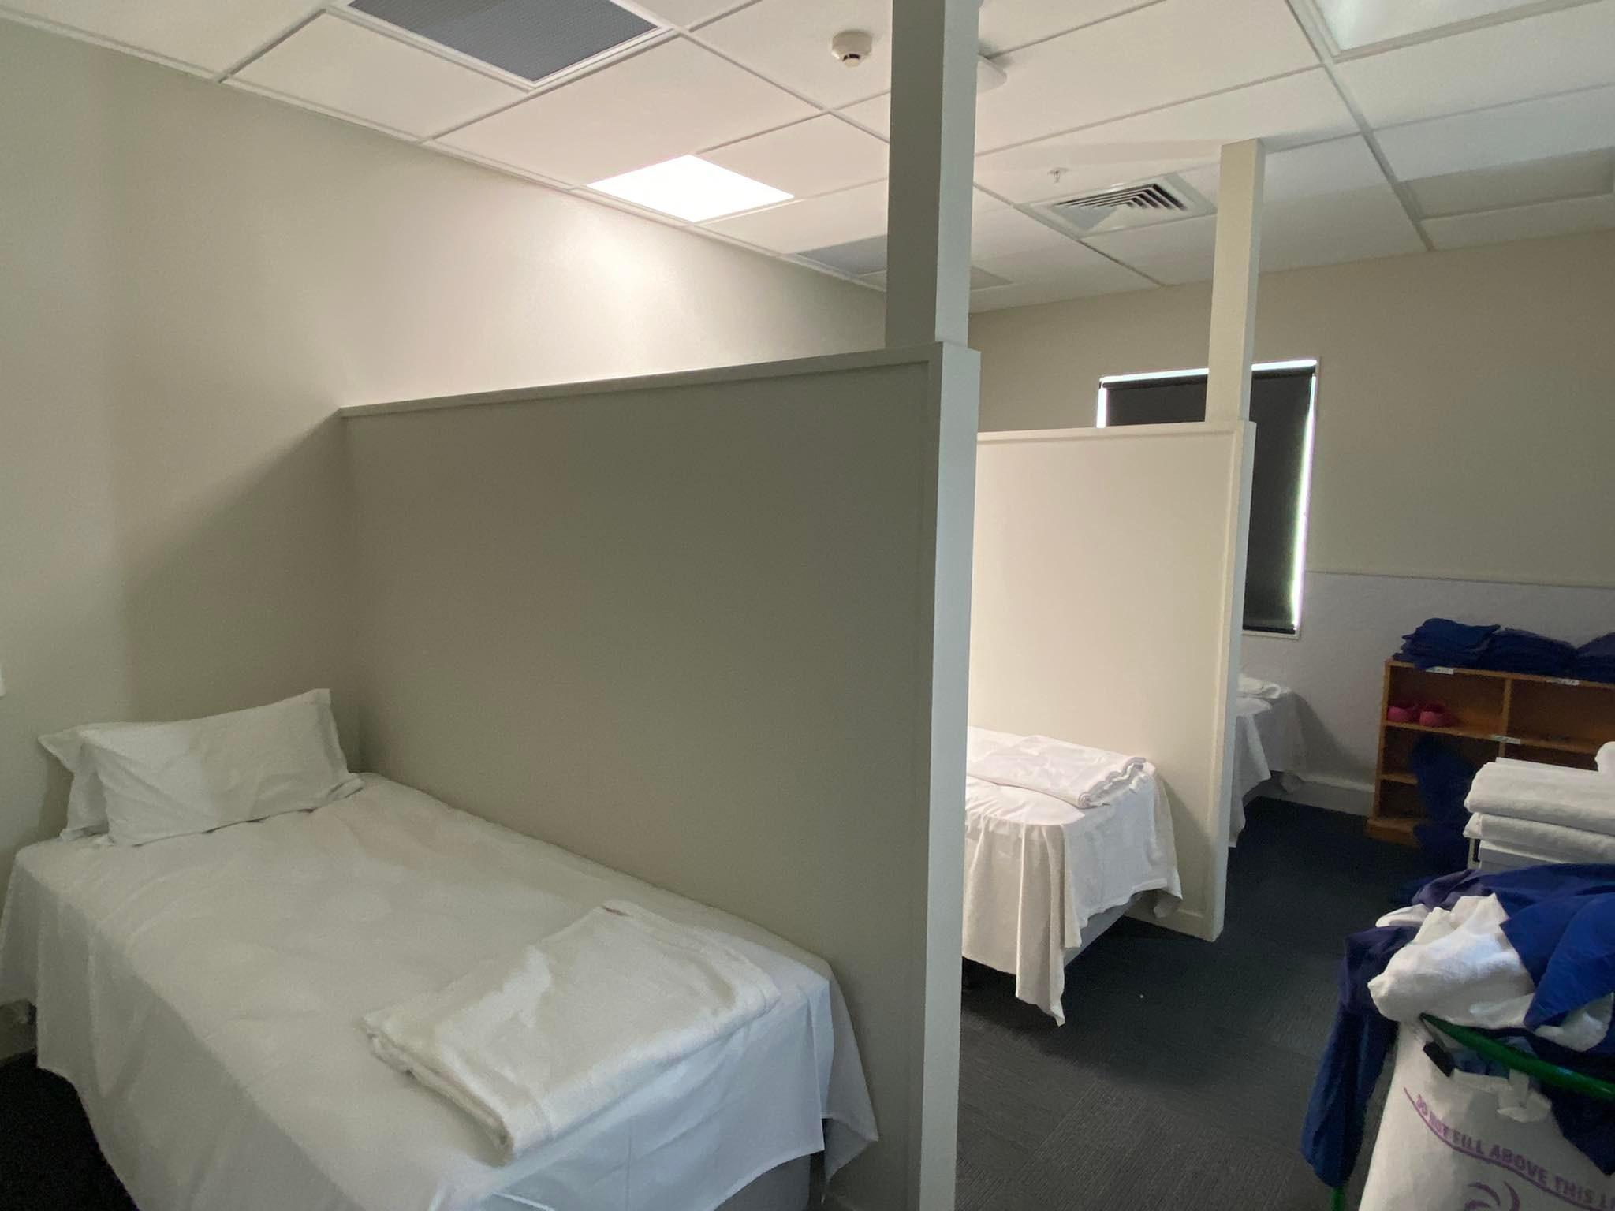
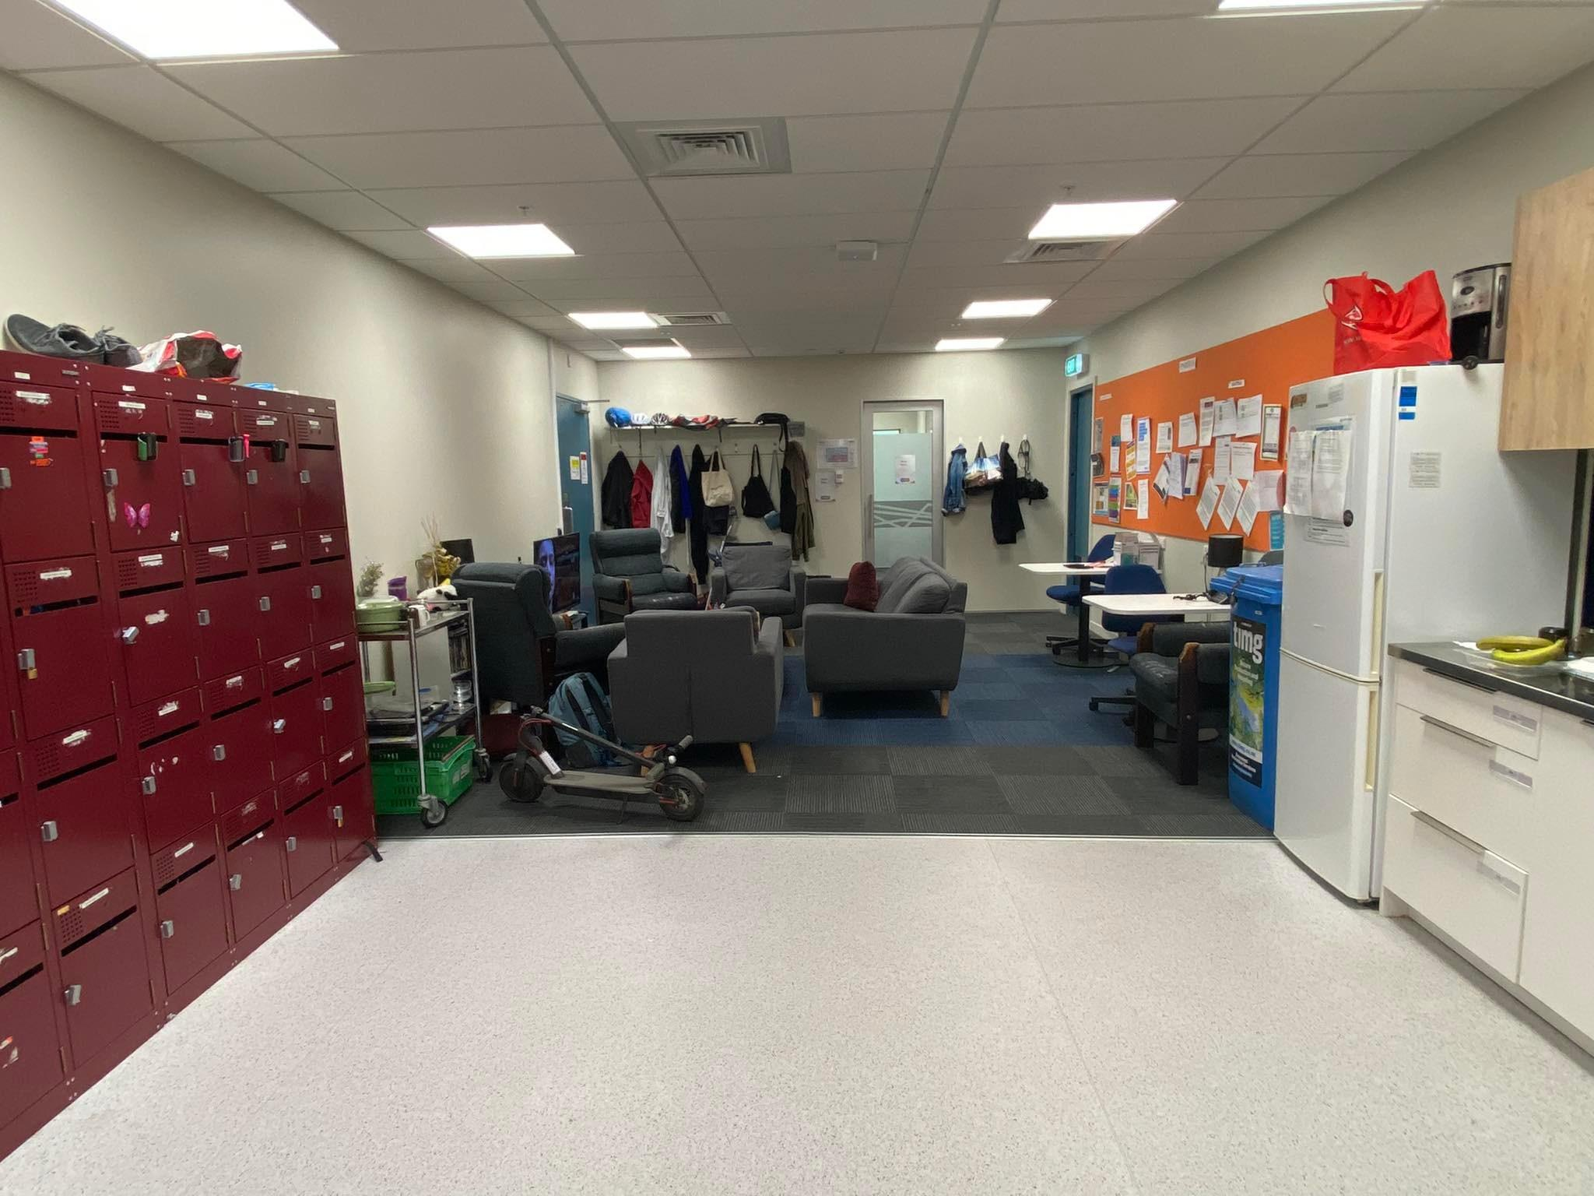
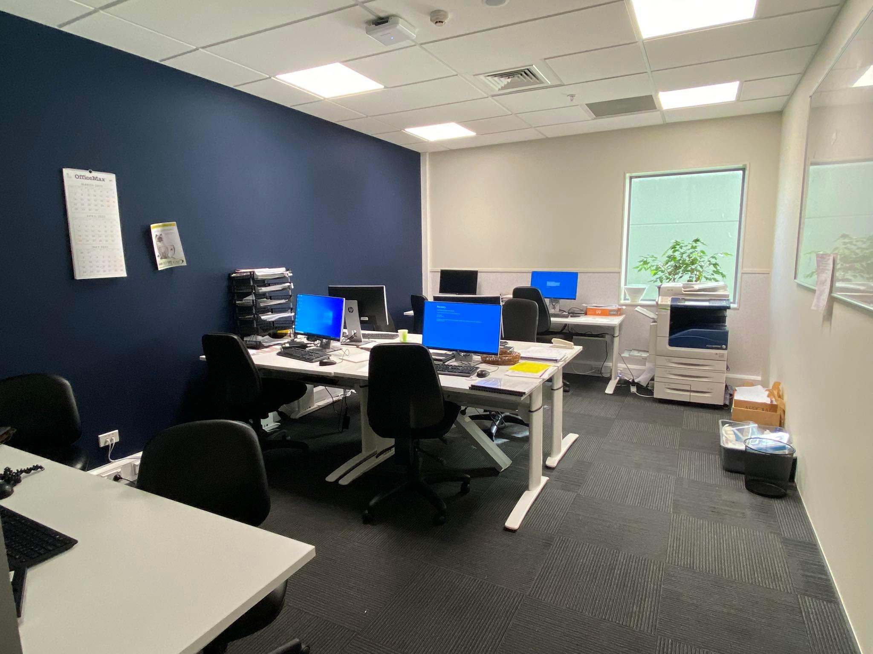
The new RMO space
Notes:
For new photos

Slide 34
Protecting Wellbeing
Generally easy, can be arranged with RMO unit, depends on the run and the time of year
We run a ballot for Christmas and New Year leave to make leave applications equitable
Try and give more than 28 days notice to ensure the RMO unit can find cover
Intern Meetings during protected teaching time to touch base with PESs/MAU and voice issues/concerns

Slide 35
The Cafeteria
Great food with a range of options
Three daily hot meal options
Salads options
Range of sandwiches
Pies, sausage rolls, hot chips, wedges
Themed food during special holidays
Snack options
Fruits including watermelon and rock melon when in season
Slices, cakes, bliss balls
Corn chips, nuts, popcorn, yoghurt
Drinks
Water
Juices
Fizzy Drinks
Spacious
You can order what you want on nights

Slide 36
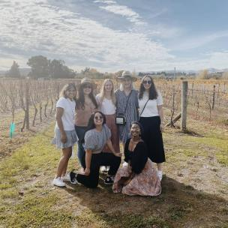
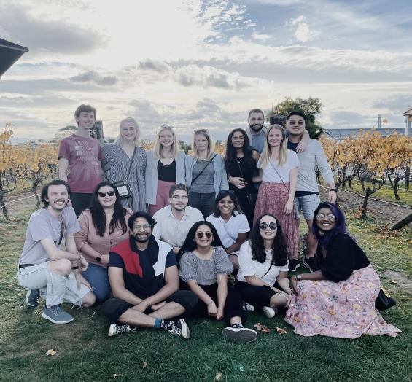
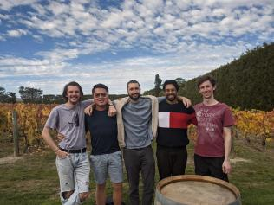
SOCIAL LIFE!

Slide 37
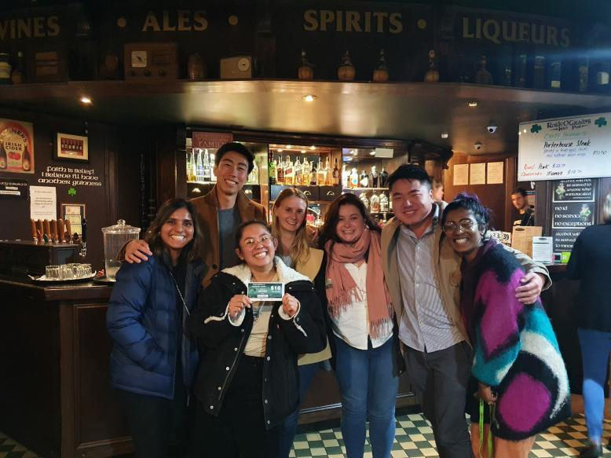

Slide 38
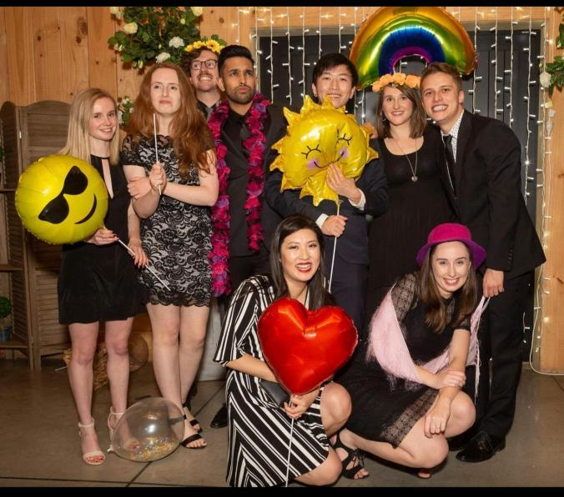

Slide 39
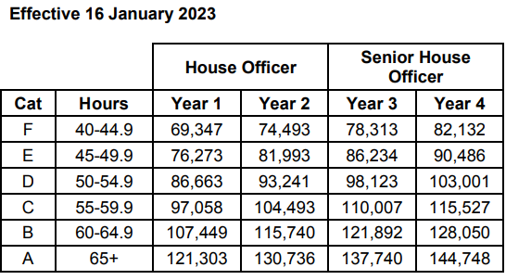
Financially

Slide 40
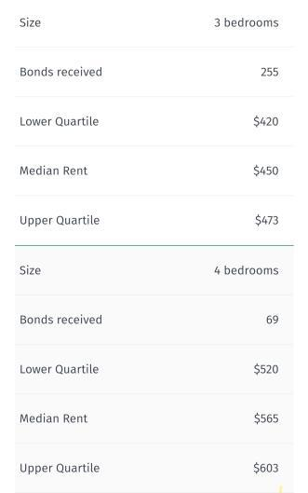
Average cost of living vs Average pay
Financial optimization!!

Slide 41
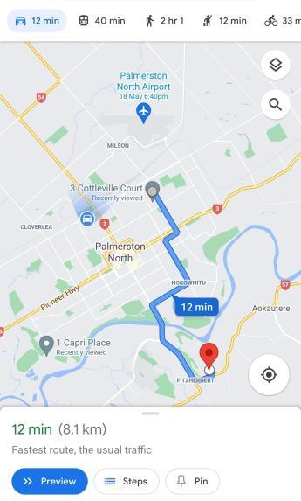
Waking up at 7am for 7 30 handover!!!
Especially handy when you're on surgery EVEN if you live on the other side of town
Paid parking at the hospital is pretty cheap
It's 10 dollars per week for a guaranteed spot with within the hospital compound.
Cannot stress this enough, seriously

Slide 42
Summary
Pros:
Very easy city to live in - everything you need close by, zero hassle
Minimal traffic and minimal stress, easy to find parks
Collegial environment - nice colleagues
Food not too bad
Available housing market and easy renting
Teaching programme designed to help junior doctors
Good opportunities for clinical growth - easy to step up
Practical procedures easier to come by
New RMO unit with study area and sleeping area
Will prepare you well for other hospitals
Mentors who will look after you and teach you a lot - help is never far away
I smile when I walk into work in the morning

Slide 43
Summary
Cons:
Poor use of technology in the hospital - a work in progress
No triaging system for pages
Using old paging system
Nil med-chart
Result paper sign offs – but progress is being made
In process of formalizing PGY2 teaching
Not a bustling New Zealand city..but it's what you make of it.

Slide 44
Questions

Slide 45
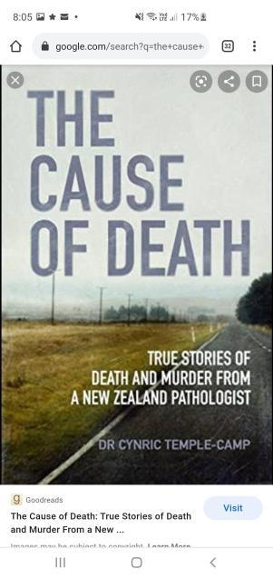
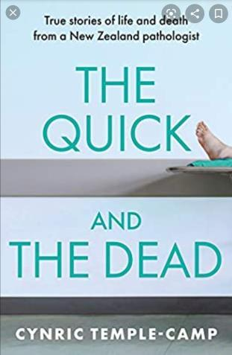
BOOKS BASED ON PALMERSTON NORTH HOSPITAL

