Slide 1
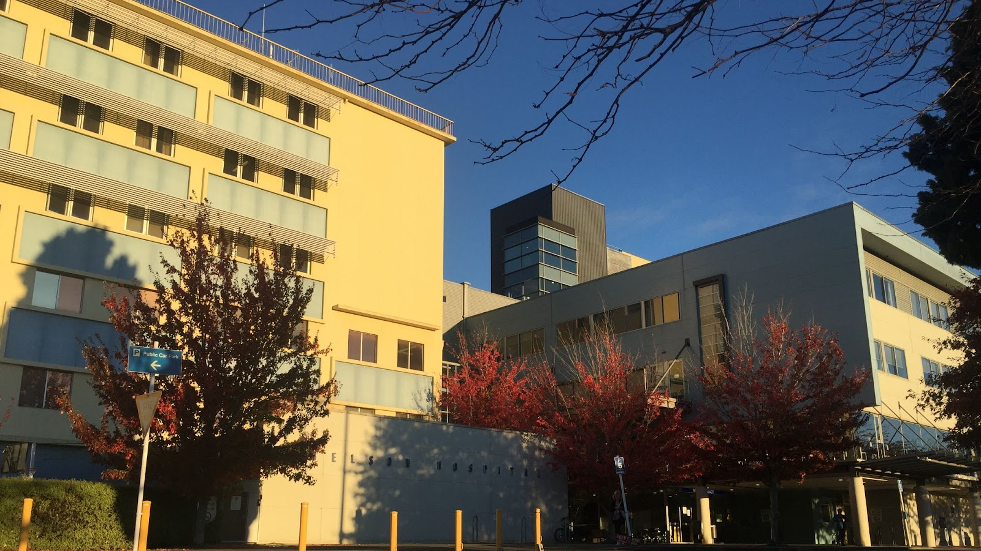
Nelson Hospital
ACE Webinar 2022

Slide 2
Kia ora!
Loretta Matheson – RMO clinical lead
Harriette Dunphy – PGY1
Emma Halsey – PGY1
Phoebe Bardoul – PGY1

Slide 3
NMDHB recruitment video
Careers at Nelson Marlborough Health – YouTube

Slide 4
Nelson Hospital
NMDHB includes Nelson and Wairau Hospital
140 bed, base hospital for the region
Nelson city population ~53,000
Services a population of over 100,000
Nearby hospitals include Wairau (Blenheim), Grey Base (Greymouth), Wellington and Christchurch
Teaching hospital
New hospital in the pipeline!

Slide 5
RMO Information
12 PGY1 positions available
46 House Officers total, 32 Registrars (training and non-training)
PGY1 runs
General Medicine (4), General Surgery (3)
Urology, ENT, Gynae/Ophthalmology, Orthopaedics
Cardiology, AT&R
PGY2 runs
O&G diploma, Paediatric diploma (6 months)
ED (6 months)
Inpatient psychiatry, Psychogeriatrics
Anaesthetics
Community: Hospice, GP, Community Psychiatry, Urgent care
Relief: Medical, Surgical, General
Pay scales: Non Urban, Category D

Slide 6
RMO Extras
Admission shifts
Shift flexibility/able to request weekends off in advance
Back up roster available
Able to get remote access from home
6% matched employer contribution to kiwisaver
1 long day per week
Do not work a long day either side of weekend worked
Weekdays after hours = one medical/surgical HO, one O&G/paeds HO (plus two admitting HO)
3 weekends per run
Work one long day and one short day in a weekend
Weekend after hours = one medical HO, one surgical HO, one O&G/paeds HO
Start nights after 9 months

Slide 7
House officer teaching
Grand round Tuesday 12.30pm
Protected teaching sessions
Wednesday 12.00 – 1.30pm (2 x 45 min sessions on clinical topics)
Thursday 12.00 – 1.00pm (wellbeing/professional development topics)
CORE/ACLS course
PROMPT, Paediatric life support, Family violence, Simulation training
Notes:
Practical obstetric multi professional training

Slide 8
Life as a PGY1…
https://www.youtube.com/watch?v=CDcsfzRRIlc

Slide 9
Why we love Nelson Hospital
Everyone knows everyone
Supportive and collegial environment
Amazing clinical experience/opportunities
Trauma calls
Rapid responses
Hands on procedures
Fellow doctors very engaging and keen to teach
Café food, environment and barista coffee
Easy to get to work, always a park
Finishing on time (with some exceptions)
Lovely patients!

Slide 10
Things to be aware of …
Some niche subspecialties not available in Nelson
Complex patients sometimes transferred to larger centres
Some complex operations not done in Nelson Hospital
Small town lifestyle = minimal nightlife
Smaller Māori & Pasifika communities compared to other regions

Slide 11
ACE applications
Mandatory Nelson specific cover letter
Interview strongly encouraged
Options for zoom or in person
Contact Loretta (RMO coordinator) to organise a time
Consideration of CV, ACE scoring and references
Connection to Nelson/whānau in the region
Very important to be able to work in a small team - being a team player is key!

Slide 12
Workplace culture
Fantastic!!
The Free House (pub)
Midwinter getaway
NMDHB Ball
Pizza night at Ros’s
Social sports teams
Onsite gym/pool for $3 per week
Nelson lifestyle is unbeatable!
Always people around who are keen for activities
Lots of UK doctors who are wanting to explore the region

Slide 13
‘The Golden Triangle’

Slide 14
Tramping/walking
Mountain biking
Running
Swimming: Ocean, river or pool
Sailing
Kite/Wind Surfing
Fishing
Skiing/Snow boarding
Kayaking/waka ama/SUP
Go to the beach!
Sports teams
Wineries
Brunch
Climbing
Thriving art community
And so much more……

Slide 15
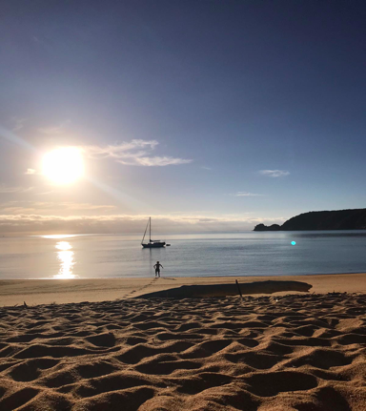
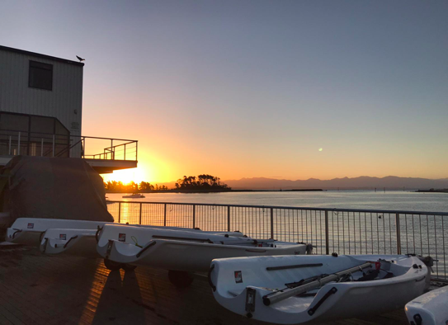

Slide 16
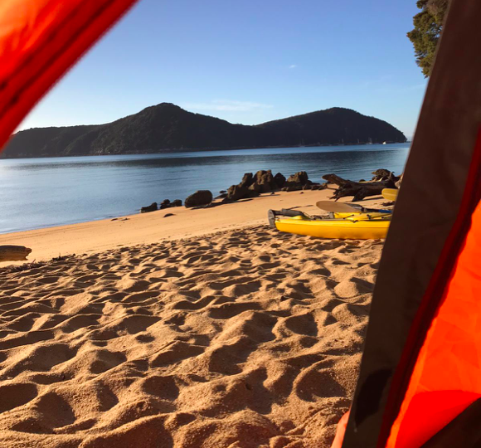
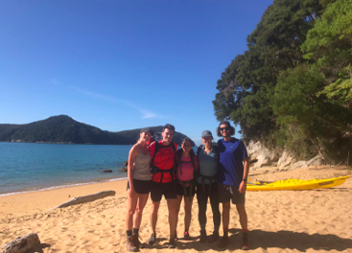
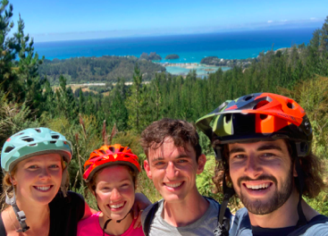

Slide 17
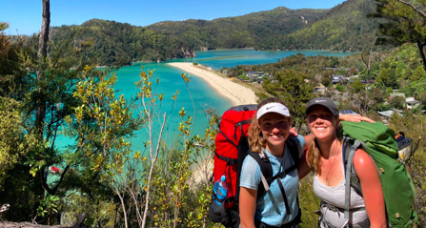
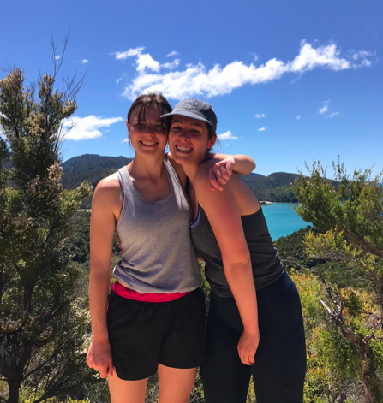
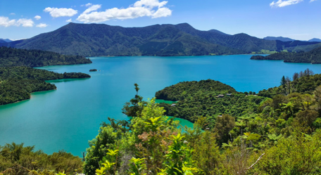

Slide 18
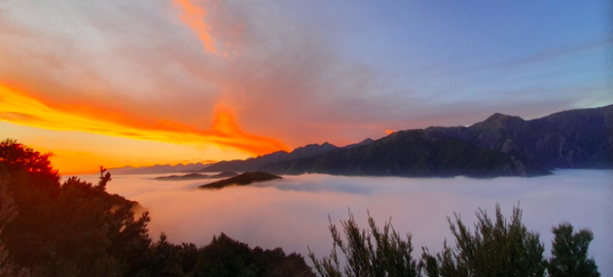
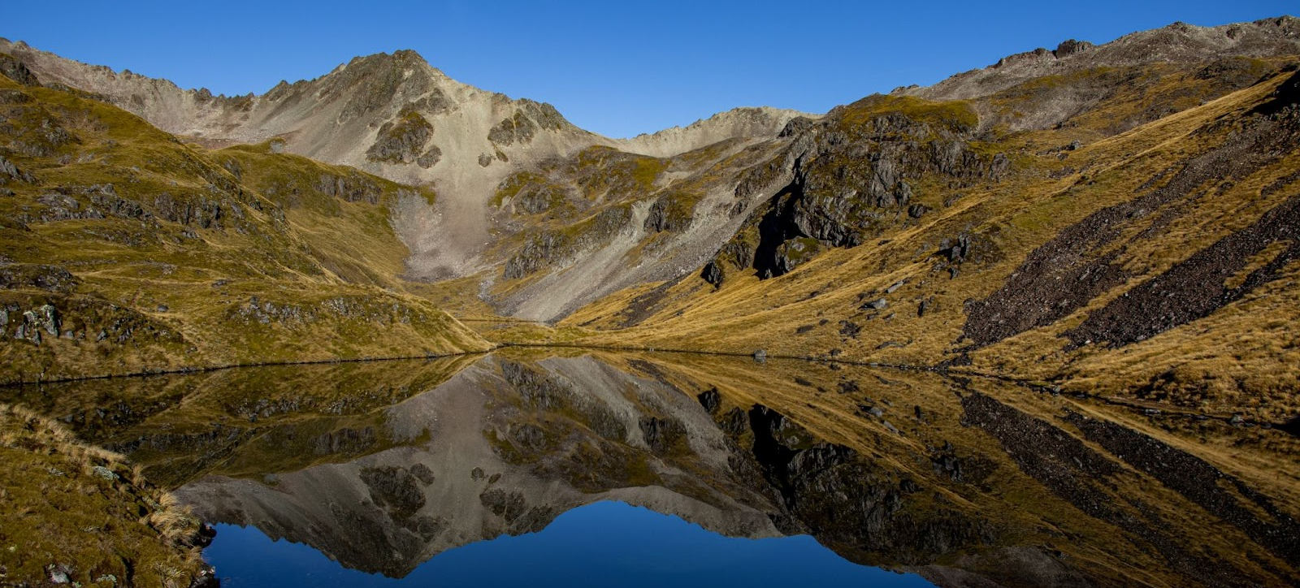

Slide 19
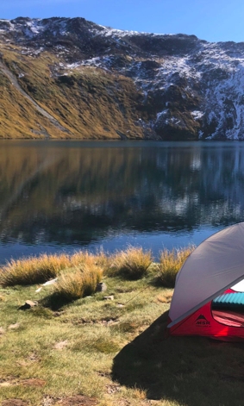
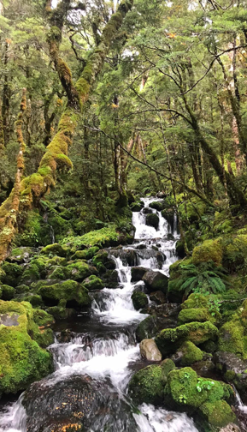

Slide 20
Get in touch!
Loretta (RMO coordinator) - Loretta.Matheson@nmdhb.govt.nz
Phoebe - Phoebe.Bardoul@nmdhb.govt.nz
Harriette - Harriette.Dunphy@nmdhb.govt.nz
Emma - Emma.Halsey@nmdhb.govt.nz

