Slide 1
Welcome to the Hawkes Bay DHB
RMO Roadshow 2022

Slide 2
Introductions
On the panel -
- Rose Siaosi– RMO Recruitment Advisor
- Grant Broadhurst - Director of Medical Training
- Jacqui Mabin – RMO Unit Manager
- Rachel Leigh – 2IC Medicine Department
- Kirsty Sutherland - PGY2
- Matt McNeill - PGY1

Slide 3
Why Hawke’s Bay DHB
Our vision is simple – we want everyone in Hawke’s Bay district to be healthy.
Hawke’s Bay Fallen Soldiers Memorial Hospital is a 410 bed secondary hospital located in Hastings. All specialties are on site (except Cardiothoracic, Plastics and Neurosurgery).
Hawke’s Bay District Health Board offers a wide range of services including sub-specialties as follows:
General Medicine
Surgical and Orthopaedics
Paediatric and neo-natal services
Intensive Care Unit, HDU and Coronary Care
Emergency Department
Radiology
Operating Theatres and Anaesthetics
Dental and Public Health Service
Mental Health and Addiction Service
Public Health
Our region has a population of close to 160,000 people, most of who reside in or around the twin cities of Hastings and Napier. There is a strong sense of community in Hawke’s Bay, and whatever your interest, chances are there will be clubs and community organisations who will offer you a warm welcome.

Slide 4
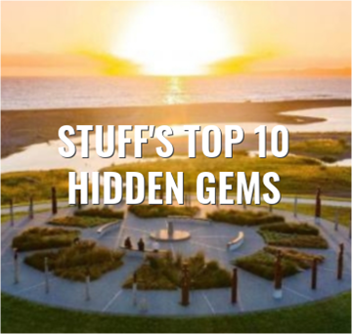
Hawke’s Bay District
The combination of fantastic weather, stunning scenery, beaches, world-class trout-fishing, easy access to the outdoors and the Central Plateau ski-fields, established food and wine experiences and a high performing hospital make Hawke’s Bay an ideal work/lifestyle destination.

Slide 5
Recruitment Process
Applications are reviewed by the Selection Panel which consists of:
Prevocational Education Supervisors (PES)
Director of Medical Training
Recruitment Advisor
We do not interview candidates.
We will review your cover letter, CV and references and give you a DHB ranking for prior contact with us.
A site visit is not mandatory.

Slide 6
Who are we looking for?
PGY1’s that are keen to work with us.
A mixture of Otago and Auckland graduates.
Team players.
PGY1’s that live our values.
Future leaders.

Slide 7
Working as a PGY1 in Hawke’s Bay DHB
20 positions.
Attachments in Gen Med, AT&R, Gen Surgery (including Orthopaedics), Relief (in Q4 only).
Vocational training in most specialties.
Regular House Officer teaching.
Informal teaching – on the job learning.
Formal teaching – Grand Rounds, Pathology meetings, Clinico-Radiology meetings, weekly teaching session.
Protected lunchtime meetings – once a week.

Slide 8
ROSTER
Roster Info
House Officers are paid Category D of the Non-Urban Salary Scale
3-4 weekends per quarter
1 rostered evening per week
1 set of night shifts per quarter – 3 days over weekend (Fri-Sun), 4 days during the week (Mon-Thu)
PGY1’s years do not work nights until the 2nd Quarter and after completing a medical run, with the support of another PGY2 or higher also rostered to nights.

Slide 9
A day in the life of an RMO here at Hawke’s Bay DHB …
Hand over to ? …

