Slide 1
Karl Haase – RDST Coordinator Supervisor
Matt Deavoll – RDST Coordinator
Karen Dreaver – METU Coordinator
Giovanni Losco – Prevocational Educational Supervisor
Will Gillespie – PGY2 House Officer
Kacey Gritt – PGY1 House Officer

Slide 2
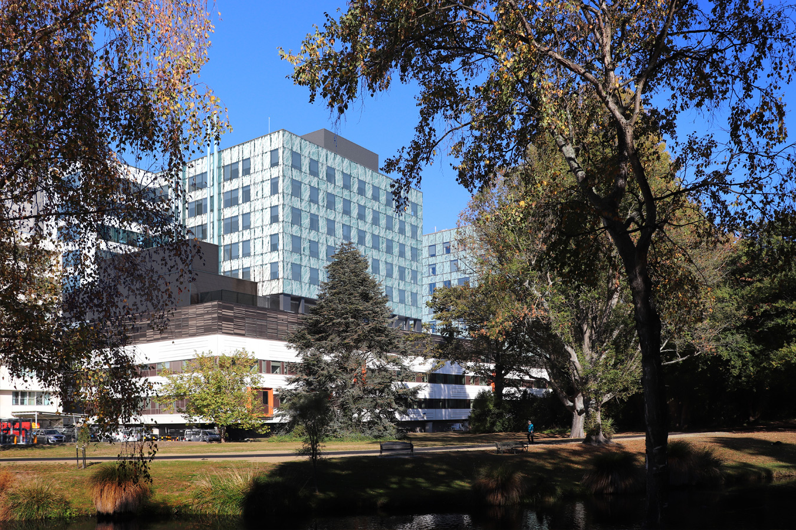
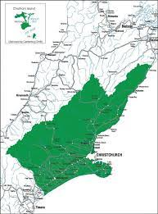
CDHB is made up of 18 Hospitals and facilities including ….
Christchurch Hospital
Christchurch Women’s Hospital
Ashburton Hospital
Burwood Hospital
Hillmorton Hospital
Kaikoura to Ashburton and the Chatham’s

Slide 3
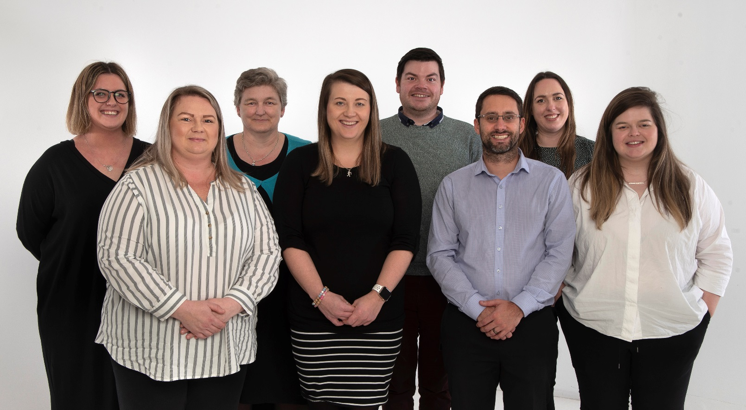
The Resident Doctors’ Support Team is the first team you will deal with when you receive your offer of employment. We handle all recruitment, onboarding, run allocations, rostering, leave approvals, afterhours rostering, run reviews, MECA implementation and all other matters that relate to your employment.
The RDST are a team of 12 located in the same office as the Medical Education & Training Unit, essentially your one stop shop for all RMO related matters.
We are a friendly team and pride ourselves on support for the RMOs in their transition from TI to PGY1.

Slide 4
Application Process
What we look for in your application?
Cover Letter
Reasons why you want to live and work in Christchurch (links to the region)
Family and friends
Sporting or cultural involvements
Training programmes the CDHB has to offer
References
References are very important to us
We require 3 references
We prefer a variety of services/areas – however not compulsory
As recent as possible
DHB Ranking
If you want to come to Canterbury, then preference our DHB first!

Slide 5
First Year Runs
Acute Psychiatry
Acute Stroke Unit
Cardiology
Gastroenterology
General Medicine
General Surgery
Neurology
Older Person’s Health
Oncology
Orthopaedic Surgery
Orthopaedic Medicine
Otolaryngology
Plastic & Reconstructive Surgery
Respiratory
Vascular

Slide 6
Second Year Runs
Cardiology
Cardiothoracic Surgery
Community Based
General Practice
Psychiatry Specialty Services
ETU Pasifika
Burnham Military Camp
Sexual Health
Haematology
Nephrology
Neurosurgery
Ophthalmology
Orthopaedic outpatients
Perioperative Medicine
Rehabilitative Medicine
Relief positions based in medical or surgical services
Rural Hospital (Ashburton & West Coast)
Urology
Vascular
In addition to the above positions there are also some 6 month positions:
Paediatrics
Obstetrics & Gynaecology
Emergency Medicine
Psychiatry

Slide 7
First Year House Officer Run Blocks 2021 Run blocks for 2022 RMO year, yet to be finalised for 2023 RMO year
 | PGY1 (Draft - subject to change) |  |  |  |  | PGY2 (Draft - subject to change)
A | GENERAL MEDICINE | GENERAL SURGERY | CARDIOLOGY | OLDER PERSONS HEALTH |  | CRISIS RESOLUTION | SURG/ORTHO ROSTER COVER
 | CHRISTCHURCH | CHRISTCHURCH | CHRISTCHURCH | BURWOOD |  | HILLMORTON | CHRISTCHURCH
B | GENERAL MEDICINE | RESPIRATORY MEDICINE | ORTHOPAEDICS | OLDER PERSONS HEALTH |  | PSYCH - C WARD/KENNEDY | GENERAL SURGERY RELIEF | COMMUNITY/GP
 | CHRISTCHURCH | CHRISTCHURCH | CHRISTCHURCH | BURWOOD |  | HILLMORTON | CHRISTCHURCH | COMMUNITY
C | GENERAL MEDICINE | GENERAL SURGERY | GASTROENTOROLGY | PLASTIC SURGERY |  | OLDER PERSONS MENTAL HEALTH | ASHBURTON
 | CHRISTCHURCH | CHRISTCHURCH | CHRISTCHURCH | CHRISTCHURCH |  | BURWOOD | ASHBURTON
D | GENERAL MEDICINE | ORTHOPAEDICS | RESPIRATORY MEDICINE | ACUTE PSYCHIATRY |  | GENERAL SURGERY - SARA | OPH COMMUNITY
 | CHRISTCHURCH | CHRISTCHURCH | CHRISTCHURCH | HILLMORTON |  | CHRISTCHURCH | BURWOOD/COMMUN ITY
E | GENERAL MEDICINE | CARDIOLOGY | GENERAL SURGERY | ACUTE PSYCHIATRY |  | ORTHO/ PLASTICS RELIEF | ASHBURTON
 | CHRISTCHURCH | CHRISTCHURCH | CHRISTCHURCH | HILLMORTON |  | CHRISTCHURCH | ASHBURTON
F | GENERAL MEDICINE | ORTHOPAEDICS | OLDER PERSONS HEALTH | OTOLARYNGOLOGY |  | CRISIS RESOLUTION | OLDER PERSONS RELIEF
 | CHRISTCHURCH | CHRISTCHURCH | BURWOOD | CHRISTCHURCH |  | HILLMORTON | BURWOOD
G | GENERAL MEDICINE | GENERAL SURGERY | GENERAL MEDICINE | CARDIOLOGY |  | OLDER PERSONS MENTAL HEALTH | ORTHO/ PLASTICS RELIEF | COMMUNITY/GP
 | CHRISTCHURCH | CHRISTCHURCH | CHRISTCHURCH | CHRISTCHURCH |  | BURWOOD | CHRISTCHURCH | COMMUNITY
H | GENERAL MEDICINE | CLINICAL ONCOLOGY | GENERAL SURGERY | ACUTE PSYCHIATRY |  | ORTHO/ PLASTICS RELIEF | COMMUNITY/GP
 | CHRISTCHURCH | CHRISTCHURCH | CHRISTCHURCH | HILLMORTON |  | CHRISTCHURCH | COMMUNITY
I | GENERAL MEDICINE | GENERAL SURGERY | NEUROLOGY | OTOLARYNGOLOGY |  | PSYCHIATRY - ROSTER COVER | ASHBURTON
 | CHRISTCHURCH | CHRISTCHURCH | CHRISTCHURCH | CHRISTCHURCH |  | HILLMORTON | ASHBURTON
J | GENERAL MEDICINE | CARDIOLOGY | ORTHOPAEDICS | OLDER PERSONS HEALTH |  | CRISIS RESOLUTION | GENERAL SURGERY RELIEF
 | CHRISTCHURCH | CHRISTCHURCH | CHRISTCHURCH | BURWOOD |  | HILLMORTON | CHRISTCHURCH
K | GENERAL MEDICINE | PLASTIC SURGERY | GENERAL MEDICINE | ORTHOPAEDICS |  | PSYCH - C WARD/KENNEDY | WEST COAST GP/PAEDS
 | CHRISTCHURCH | CHRISTCHURCH | CHRISTCHURCH | CHRISTCHURCH |  | HILLMORTON | GREY HOSPITAL
L | GENERAL MEDICINE | GENERAL SURGERY | OLDER PERSONS HEALTH | ACUTE PSYCHIATRY |  | GENERAL SURGERY - SWING | COMMUNITY/GP
 | CHRISTCHURCH | CHRISTCHURCH | BURWOOD | HILLMORTON |  | CHRISTCHURCH | COMMUNITY
M | GENERAL MEDICINE | GENERAL SURGERY | GENERAL MEDICINE | CLINICAL ONCOLOGY |  | CRISIS RESOLUTION | ORTHO - PAEDS/SPINE
 | CHRISTCHURCH | CHRISTCHURCH | CHRISTCHURCH | CHRISTCHURCH |  | HILLMORTON | CHRISTCHURCH

Slide 8
Run Block Example
Block A
PGY1
PGY2
GENERAL MEDICINE | GENERAL SURGERY | CARDIOLOGY | OLDER PERSONS HEALTH
CHRISTCHURCH | CHRISTCHURCH | CHRISTCHURCH | BURWOOD
CRISIS RESOLUTION | SURG/ORTHO ROSTER COVER
HILLMORTON | CHRISTCHURCH
Block K
PGY1
PGY2
GENERAL MEDICINE | PLASTIC SURGERY | GENERAL MEDICINE | ORTHOPAEDICS
CHRISTCHURCH | CHRISTCHURCH | CHRISTCHURCH | CHRISTCHURCH
PSYCH - C WARD/KENNEDY | WEST COAST GP/PAEDS
HILLMORTON | GREY HOSPITAL

Slide 9
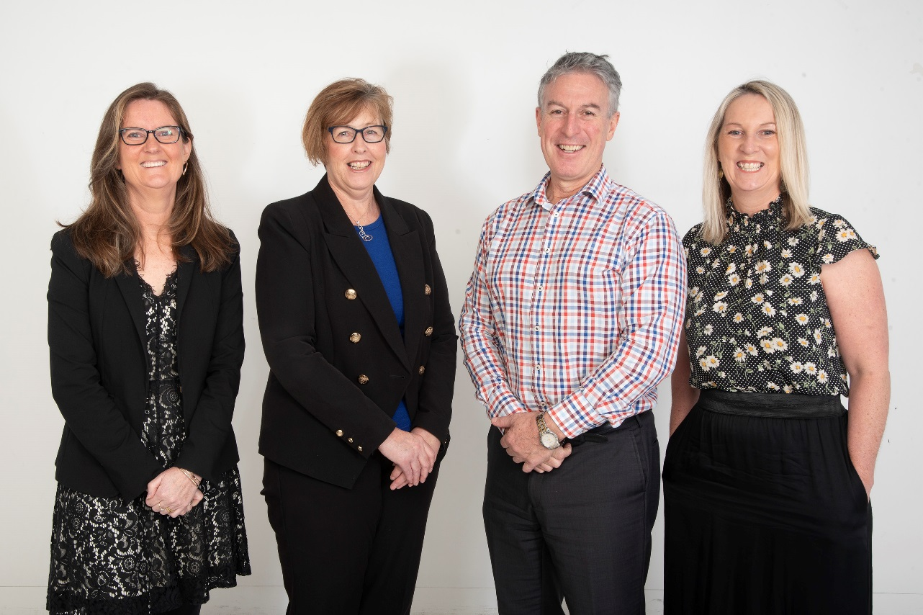
We are responsible for the overall education and clinical training for all RMOs not in a vocational training programme. We ensure that junior medical staff receive the training and supervision that is needed to meet the requirements set by the MCNZ.
We seek to identify, develop and implement best practise in medical education and training initiatives.

Slide 10
Supervision
Educational Supervisors
METU appointed PES that stay with you for your first 2 years.
Clinical Supervisors
Service appointed supervisor that you will meet with several times during your run.

Slide 11
Teaching Programme and Facilities
PGY1 teaching, every Wednesday 3:30-5:00pm
PGY2 teaching, every Thursday 12:30-1:15pm

Slide 12
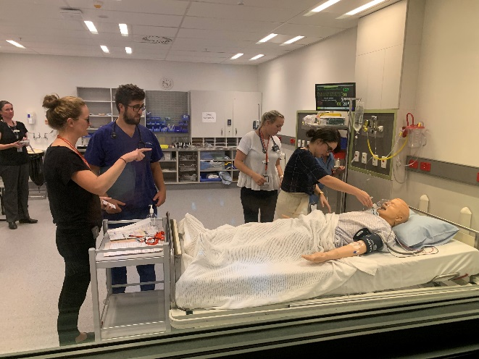
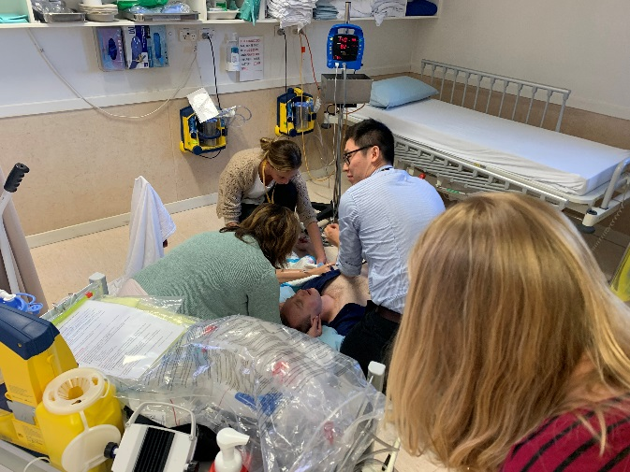
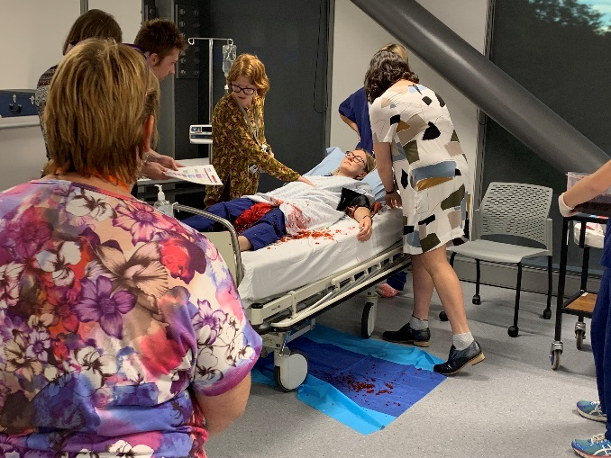
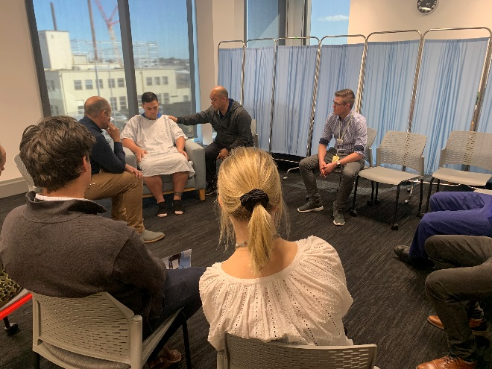
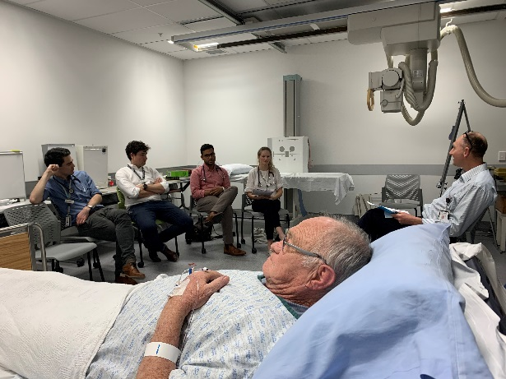
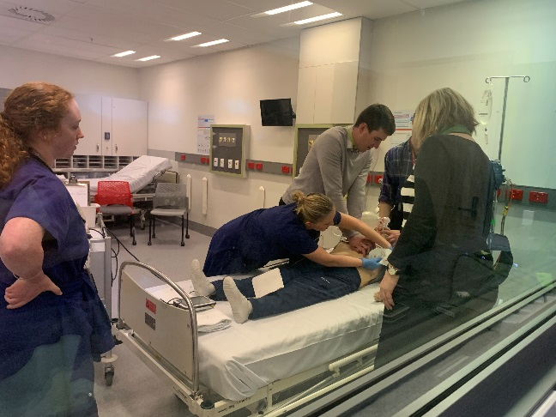
Scenario training
20 min Rapid Fire
Sick and Deteriorating Pt
Site specific IP scenarios at Burwood and Hillmorton Hospitals at the commencement of each run
Haoura Maori following the Meihana Model in collaboration with MIHI

Slide 13
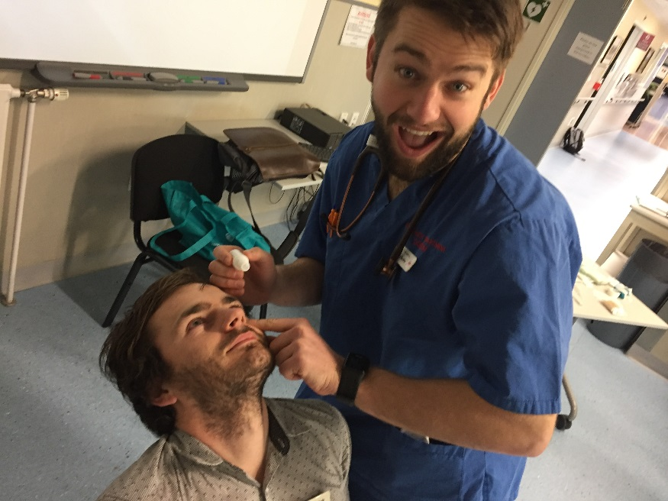
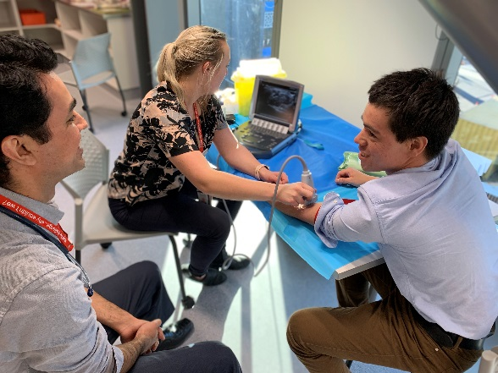
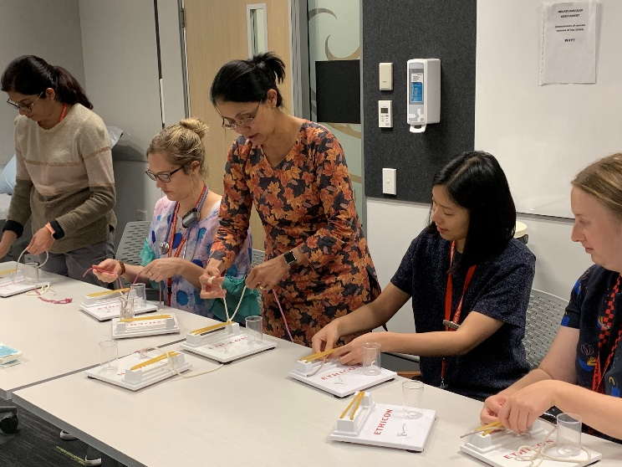
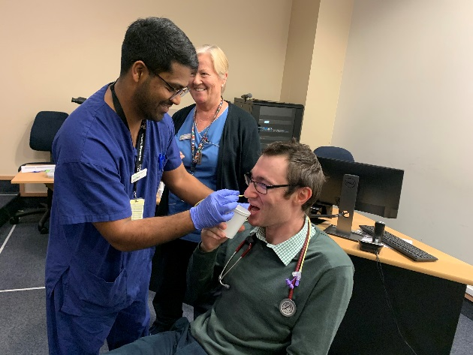
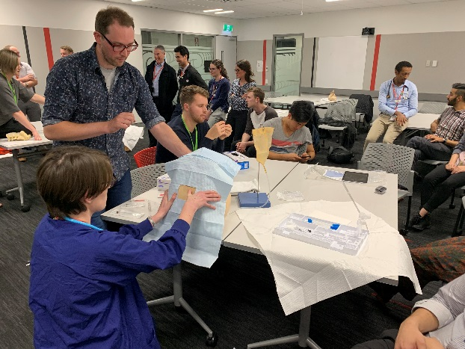
Practical Skill Sessions
Nasogastric tube placement – IP approach
Suturing and knot tying
Airway management
USS guided IV placement
LP
Ophthalmology

Slide 14
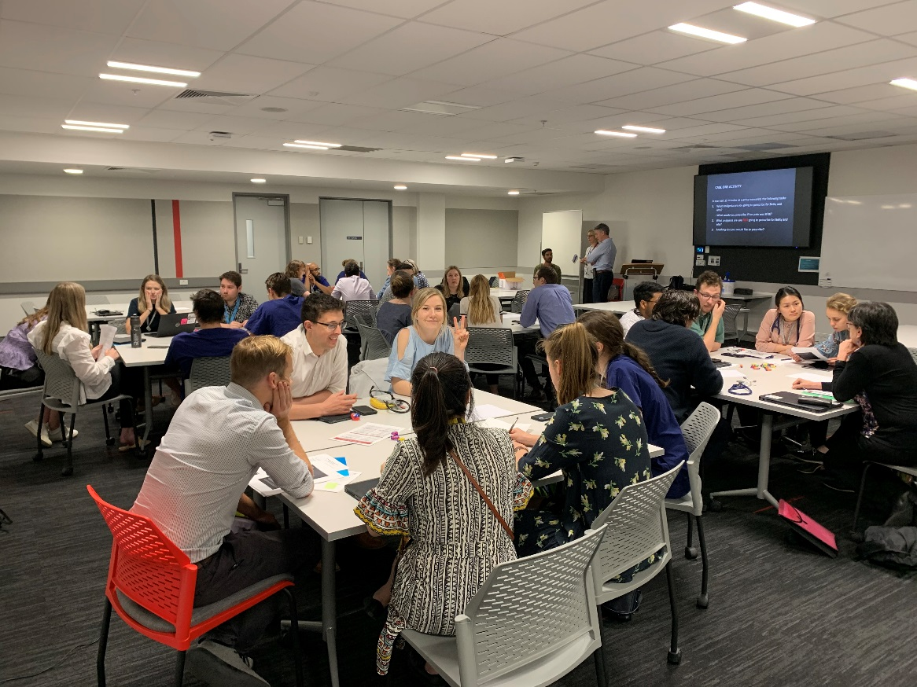
Workshops
Wellbeing and Resilience
Pharmacy
Conflict management
Serious Illness Conversation
Guide (SICG)
*Inter professional and
multi-disciplinary focussed teaching .

Slide 15
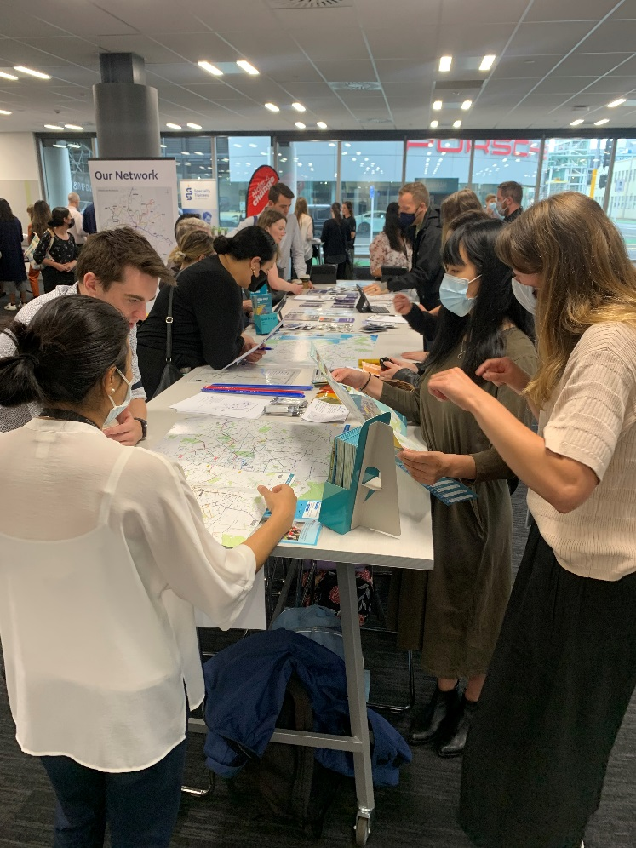
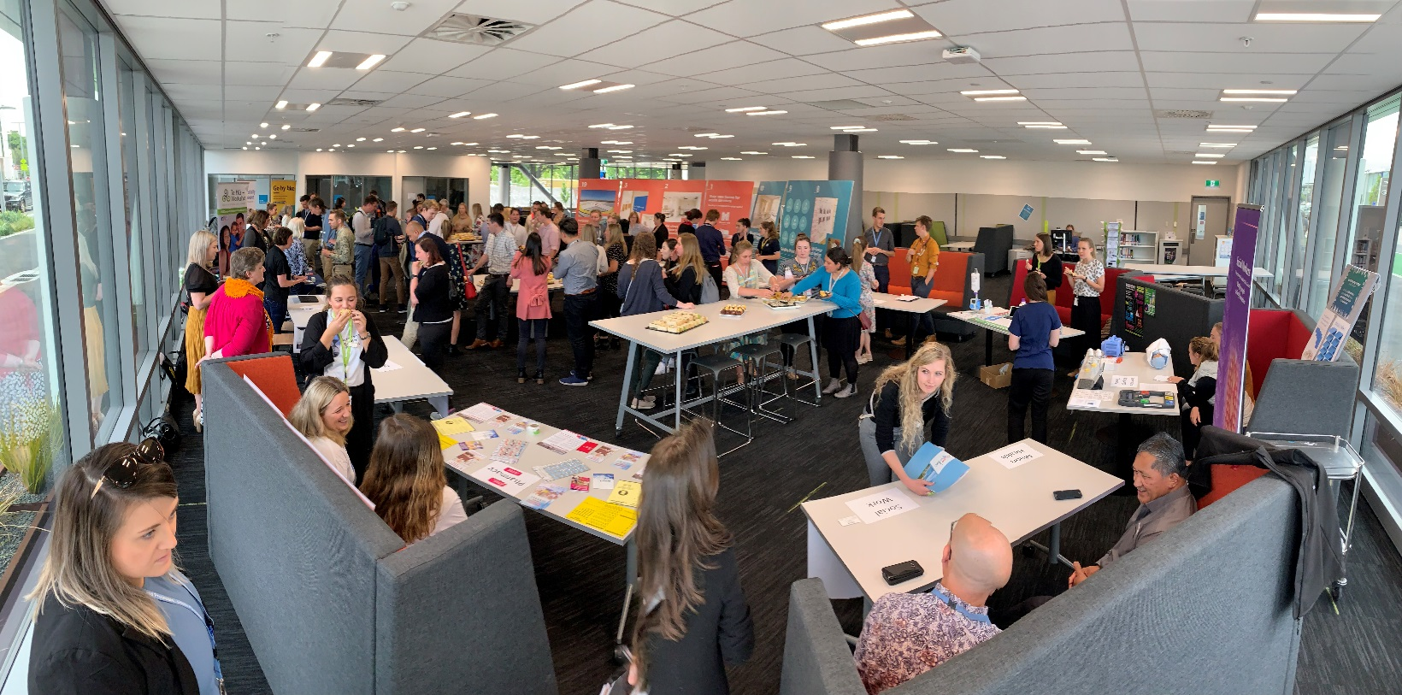
Clinical Orientation
Four days – mid January
Computer application programmes
CTCs and Handovers
HO survival guide
Discharge summaries
Day in service
EXPO

Slide 16
METU Check Mate Mentor Scheme
Friendly face to ask questions
Non-judgemental
Visible and available around hospital
Mentors are volunteer RMOs who are PGY2 and above

Slide 17
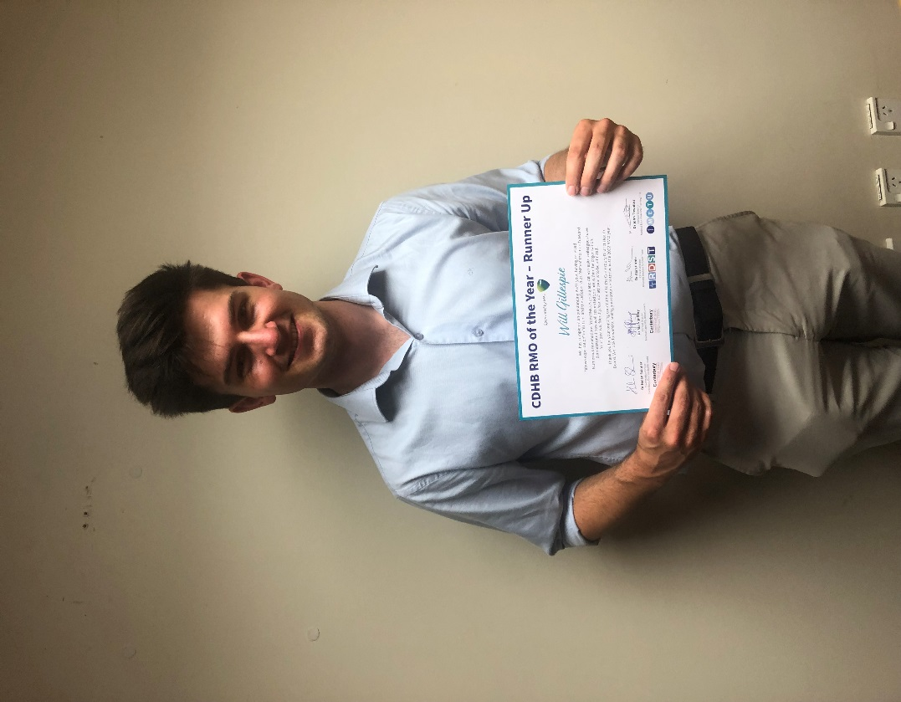
Additional Supports and Rewards
RMO of the month
RMO training committee
End of run evaluations
Vocational Pathways Evening
Weekly newsletter
Canterbury Healthcare Challenge

Slide 18
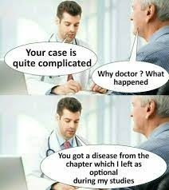
Introducing first year House Officer Dr Kacey Gritt and second year House Officer Dr Will Gillespie
A day in the life of a House Officer here at the CDHB
Working at the CDHB
Rosters
Training, Teaching and Support
Clinical Team Coordinators (CTC)

Slide 19
The Christchurch experience
Friendly environment
Good support on duty shifts
CTCs to triage calls/tasks
Additional after hours support for first 4 weeks
Clinical resources – HealthPathways, Pink Book…
Electronic tools to improve workflow eg Cortex notes
Educational opportunities
Medical library associated with the Otago campus
METU teaching programme, run-based teaching
Busy dynamic hospital, large size

Slide 20
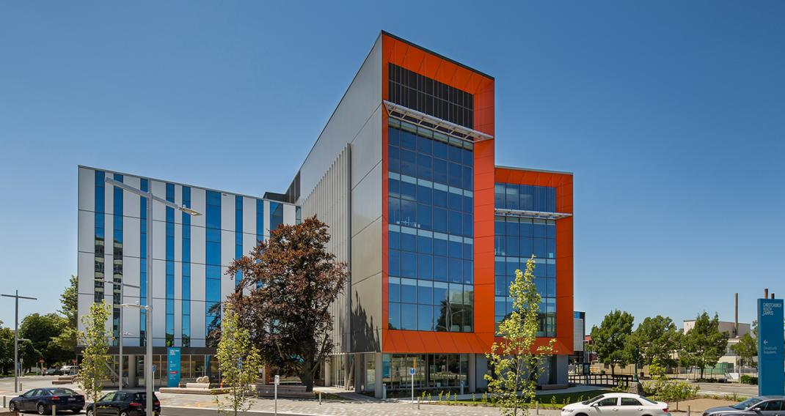
Day in the life of an RMO
Login to Cortex, read up on progress notes
from overnight
Draft round notes
Round – usually with registrar or SMO
Jobs
Radiology requests, send/request investigations, consults & referrals, discharges (urgent or planned may be done sooner)
Review obs/labs/radiology/patients of concern before lunch
Chase jobs, prep tomorrow’s discharges
Handover (jobs to chase, unwell patients for review…) & go!

Slide 21
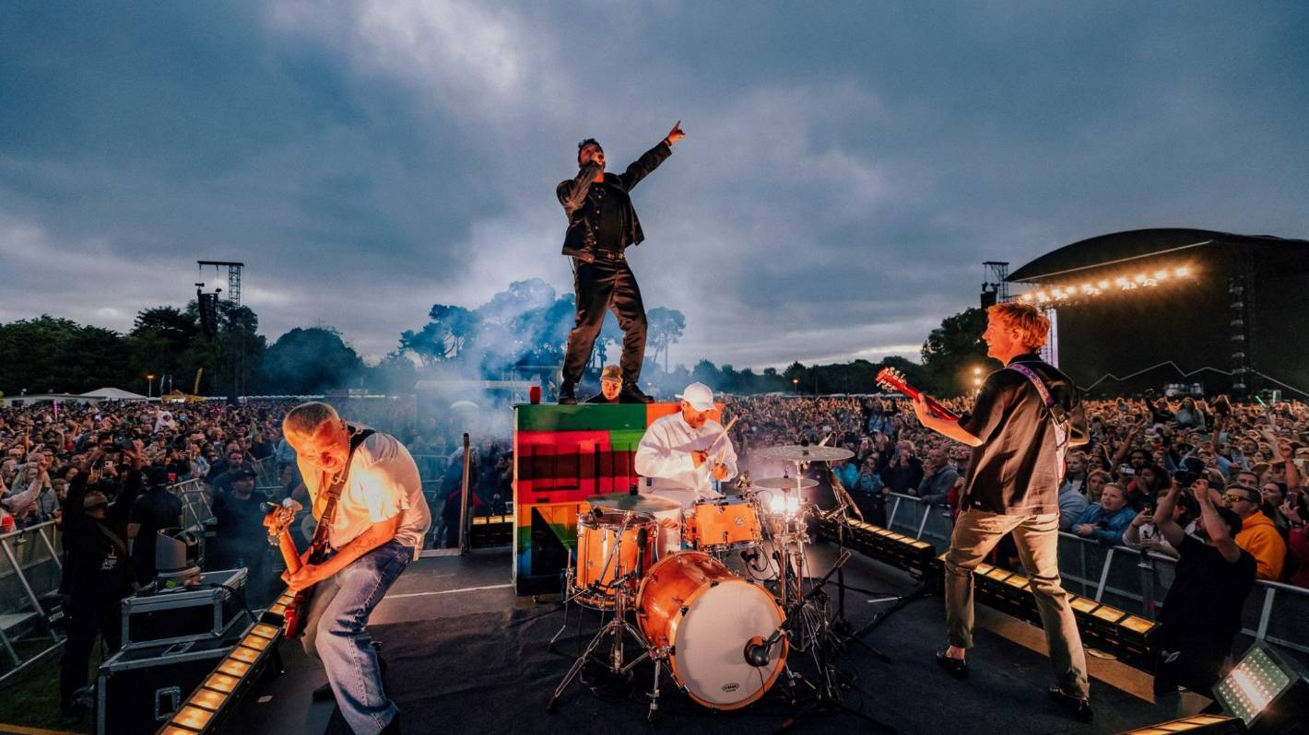
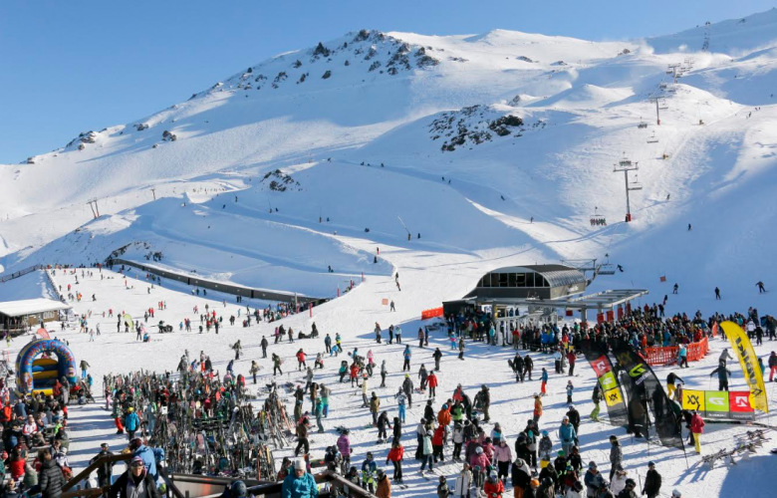
Work-life balance
The great outdoors
Tramping – Arthur’s Pass, Lewis Pass, West Coast
Skiing – great fields in close proximity
Banks Peninsula – surfing, mountain biking
The city
Vibrant cafes, restaurants, festivals and shows
Good shopping
Improving every year!
Travel
International airport

Slide 22
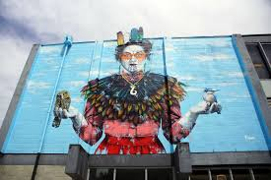
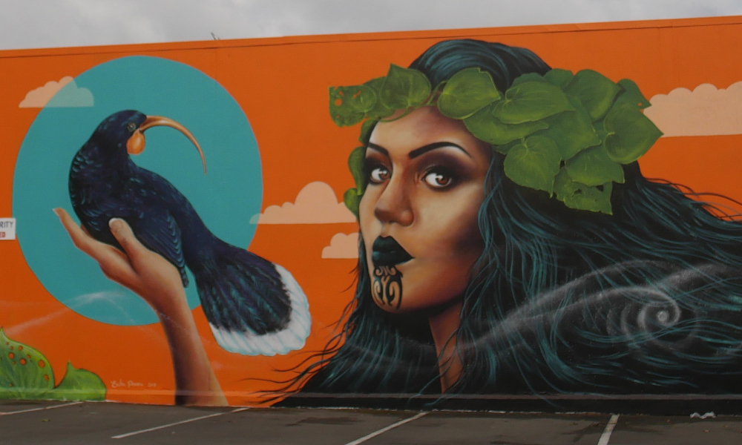
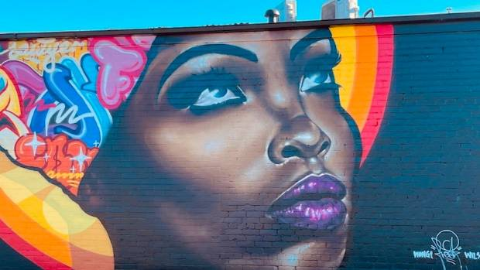
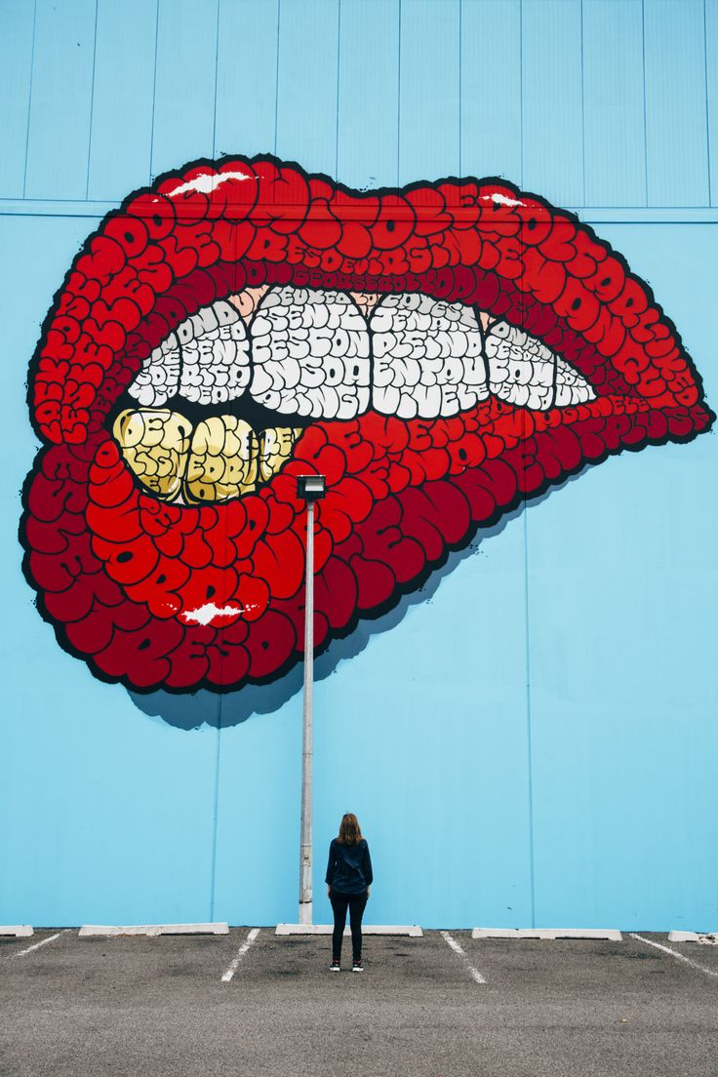
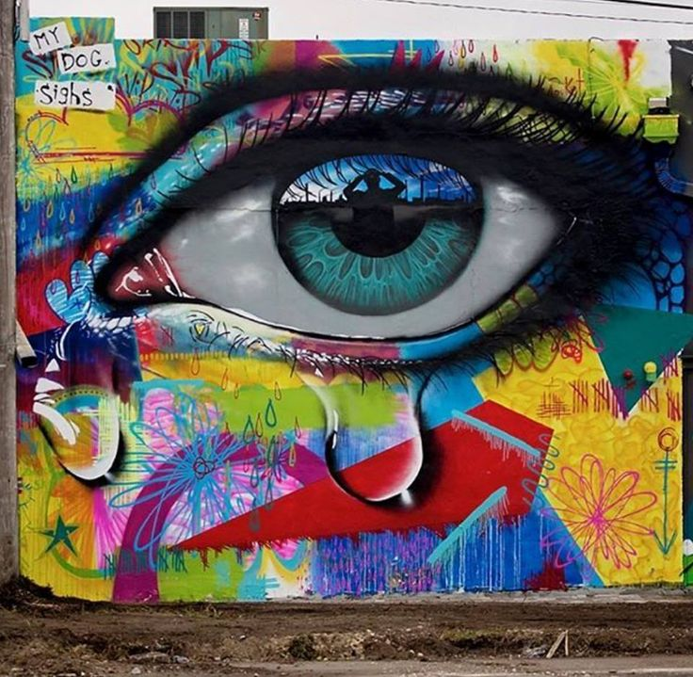
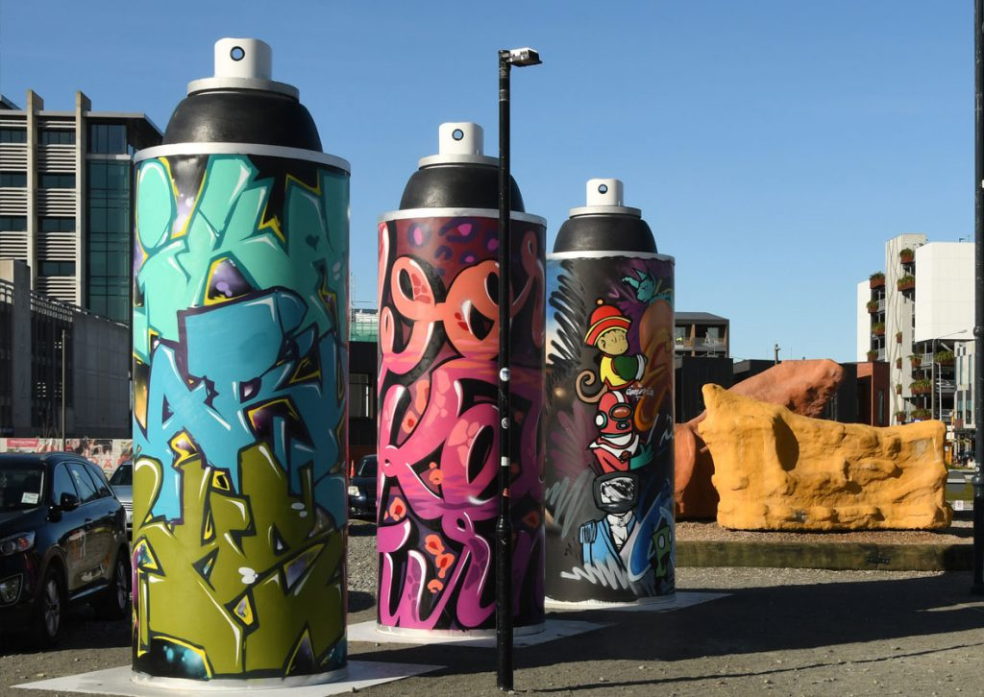
Top tips
Read start of run docs
Available on METU website
Runs have associated information documents on ePort
Useful for tailoring goals and for self-directed learning
If unsure, ask another RMO, ask reg/SMO
Especially relevant on duty shifts
No-one should be unkind for asking questions
Safer to ask than justify why you didn’t!
Remember the Check-mate mentoring scheme
If you have unwell or challenging patients it can
be useful o leave a plan

Slide 23
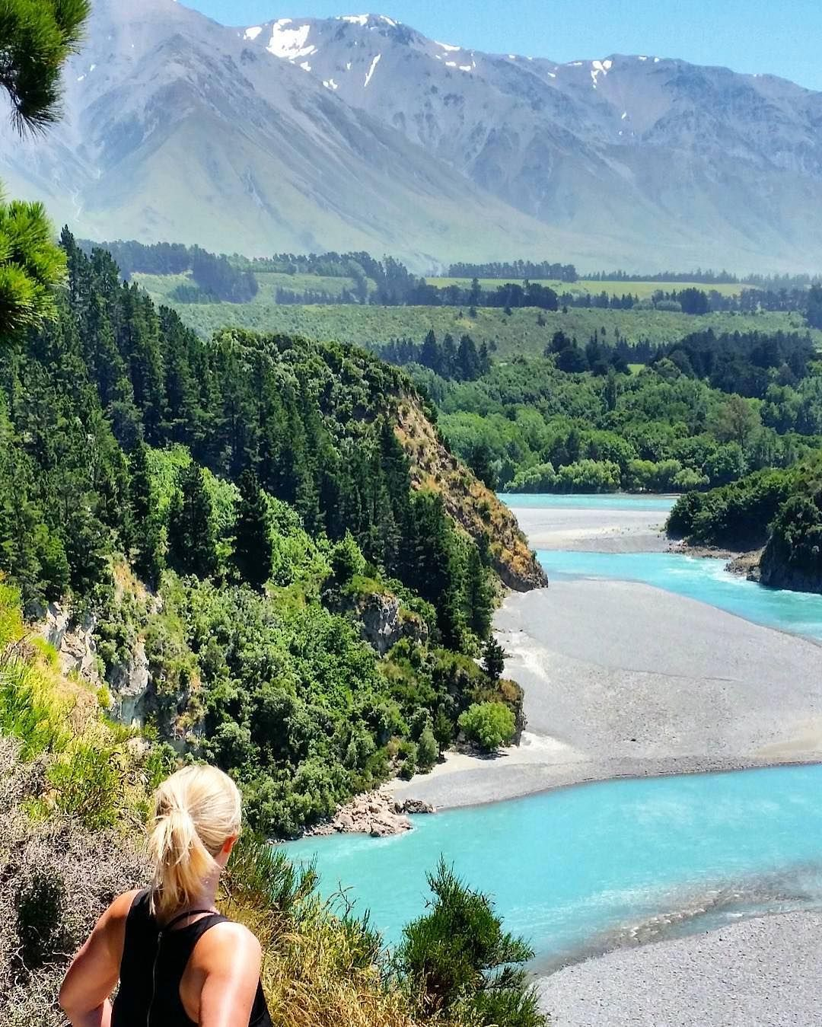
See you next year!

