Slide 1
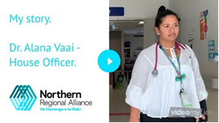

Slide 2
Why Auckland? Hear from our RMOs & NRA team

Slide 3
The House Officer Recruitment Process
Notes:
Now that we’ve heard from Naomi and Josh regarding why they chose Auckland, let’s look at the Recruitment process and how you can join us in Auckland too!

Slide 4
The House Officer Recruitment Process
No interview
Ranking Process – ACE and PVTC
Carried out by a representative subgroup of PVTC members and Intern Supervisors, with House Officer representation
Based on the “Fit for Purpose Practitioner” model.
 | Score
Excellence | 3
Good | 2
Satisfactory | 1
No evidence of completion | -1
Unacceptable | -1
CV
References
Academic Transcript
Cover Letter
Notes:
As long as you have ranked at least one of the 3 DHBs in the Auckland region and have a completed application, then we will receive your application from ACE on the 20th July so you do not have to have ranked all 3 DHBs in the Auckland region. We also do not know where on the preference list each hospital you have ranked are, only that it is one of your preferred DHBs. We have no interview process … 400 applicants for each of the 3 DHBs and we only have 60 odd positions. – Clinical performance, team approach, personal development and professionalism. We are looking for well rounded individuals

Slide 5
“Fit for Purpose Practitioner” model

Slide 6
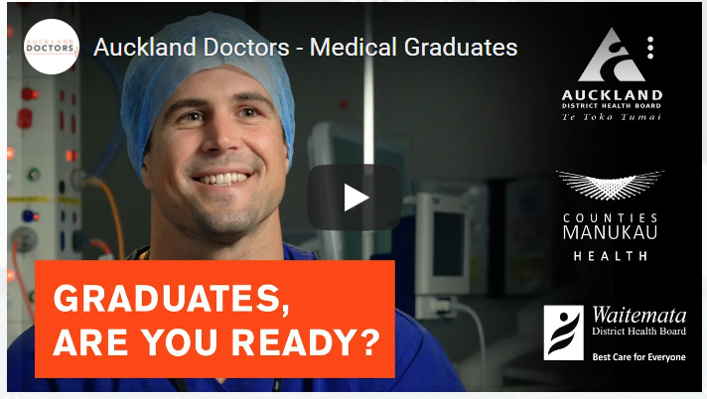

Slide 7
A day in the life of our RMOs
What is it like to work at the hospitals in the Auckland region? Why did you choose Auckland? What advice would you give to new PGY1s?

Slide 8
Questions?

